Slide 1
Class impressions : Higher class elicits lower prosociality 汇报人：贺哲

Slide 2
Introduction
1.class has been found to impact how people balance self- with other-interest in their social environment. For example, some findings suggest that lower class individuals are more prone to exhibit a number of prosocial behaviors relative to higher class individuals.
2. low income, but not low socio-economic status (SES) tar- gets are more desirable bargaining partners ，and that powerless targets receive higher offers in an ultimatum game than targets with some power .
3. Although much previous research has sought to understand how self social class relates to prosociality, only a few studies provide hints at how target social class influences behavior.

Slide 3
perceptions of social class
Objective(e . g. income and education)+subjective(perceived relative class ranks) assessments=class
social mindfulness and prosociality
Prosociality behavior: social value orientation , personality scales, behavior variables(charitable giving, volunteering),decisions in economic games and social dilemmas , social mindfulness.
which we use here, is known as social mindfulness, which reflects an openness to the needs and wishes of others in the present moment .
like leaving or limiting choice for others who also have a stake in the out- come of an interdependent situation .

Slide 4
social mindfulness and prosociality
社会正念的somi范式：一种测量社会正念（社会正念是在人际互动中，个体关注他人切实需要和利益，维护他人的自主选择权利，做出利他选择行为的心理过程）的范式，在该范式中，个体和另外一个人先后多次选择物品，每次选择包含三个或四个物品选项，例如：一个黄色篮球帽和三个蓝色篮球帽、一个绿苹果和两个红苹果等。如被试作为先选者，选择了相同颜色的物品，则后选者仍有选择的机会，此时被试得到利他选择分数；相反，被试选择不同颜色的物品，后选者失去对物品选择的机会，此时被试不得分。SoMi 范式下，先选者的行为选择决定了后选者是否拥有自主选择权。根据自我决定理论，自主需要即自主选择是人类最基本的需要，社会正念利他选择强调了情境中两人的相互影响，让他人有自主决定的行为可以看作是一种尊重他人的需要，是为他人考虑的利他行为。

Slide 6
three broad perspectives
Fairness perspective:低阶层群体受到更多社会正念，因为他们所得到的资源有限；高阶层反之。
Status perspective：高阶层群体受到更多社会正念，因为人们通常会考虑到他人的理想品质
Similarity perspective：人们倾向于对属于自己同样阶层的群体表现更多社会正念。

Slide 7
Higher class individuals tend to be less prosocial。 psych
Higher class individuals are more prosocial。 sociology

Slide 8
Guiding impression –four studies
We sampled u. s. residents using Amazon Mechanical Turk service（MTurk）:
1.They are more representative of the general us population.
2. MTurk participants appear to at- tend to instructions as well as student participants and to respond to experimental stimuli in ways similar to participants in research labs .
3. MTurk participants are more socio-economically diverse than undergraduate samples

Slide 9
Study1:higher versus lower class targets
1.Aim:two types of relationships between class and prosociality.
2.Participants：226 （126female，18-78years old，Mage=37.44，40% master’s degree,35% bachelor’s degree,11%technical degree,24%post-secondary school,16%high school or less.
General prosocial tendencies
Assessment of prosocial tendencies toward a specific target

Slide 10
Study1:higher versus lower class targets
Objective social class was assessed by annual household income.$5000$20000$150000 Mincome = $45,000–49,999, me dian = $35,000–39,999)
Social class
we would like you to think of the ladder below as representing where people stand in the United States in terms of education, income, and job status
where the people who are the worst off are on the bottom
Subjective social class was established by asking participants to complete the MacArthur Scale of subjective SES .
the people who are the best off are on the top.
Where would you place yourself relative to the people who are the best off and the people who are the worst off in terms of education, in- come, and job status
The mean was below the scale midpoint (Mladder = 4.42, SD = 1.73, t(225) = −5.05, p ，<0.001), 45% of the participants placed themselves on the middle rung or above. This suggests that our sample was not, as a whole, unusually high or low in social class, and that we sampled from a range of social class that was broad enough to test our hypotheses.

Slide 11
Study1-General prosociality
SVO: measures degree of proself versus prosocial orientation across six items in which participants select their preference between various payoffs for self and an unspecified other.
Frequency of volunteering: measured by summing participants' engagement in 11 different activities over the past year (1 = did, 0 = did not; α = 0.76)
Personality dimensions honesty-humility and agreeableness :using the 36 applicable items from the HEXACO-PI-R-100 ,the personality dimensions honesty-humility (16 items; α = 0.88) and agreeableness (16 items; α = 0.91) were assessed, together with an interstitial altruism facet (four items; α = 0.70)

Slide 12
Study1-social mindfulness
Some experimental trials included one unique item and two identical items (e.g., one gold colored gift box and two red colored gift boxes), and others included one unique item and three other identical items (e.g., one green apple and three red apples)
Higher class target :a man in his mid-40's. He graduated from a prestigious, highly ranked university. He has a desirable job, and he currently earns approximately $150,000 every year. He lives in a very nice neighborhood and he drives a very nice car.
participants were instructed to select one of three or four items that were shown onscreen, and they were instructed to do so as if they were the first of two people choosing items without replacement.
Lower class target:a man in his mid-40's. He graduated from high school, but he never attended college or university. He has a job that is not very desirable, and he currently earns approximately $40,000 every year. He lives in a neighborhood that is not very nice and he drives an old, beat up car.
Control:two versus two (when there were four items in a trial) or three identical items (when there were three items).

Slide 13
Result and discussion
1.Participants who imagined interacting with a lower class target scored higher on social mindfulness than those who imagined interacting with a higher class target, t(224) = 5.23, p b 0.001, d = 0.73, Mlower = 0.75 (SD = 0.21), Mhigher = 0.59 (SD = 0.23)
support for a fairness perspective, against the status perspective
2.The tests of the interaction between target and participant class were non-significant
This is inconsistent with the similarity perspective.
3. The target effect remained after control- ling for honesty-humility, agreeableness, participant social class (in- come and ladder), SVO, age, and sex, F(1, 217) = 28.72, p b 0.001, η2 = 0.10.
4.participant social class was unrelated to prosociality across all of our measures in Study 1 .
only the (positive) relationship between the SES-ladder and volunteering frequency approached significance.

Slide 14
Study2-reward or reprove
Aim : whether participants were more prosocial toward the lower class target, or rather less prosocial toward the higher class target relative to a class unspecified target .
Participants:300(162women,19~73years old,Mage=76.72,SD=12.64)
Social class and general prosociality：all same as the study1
Social mindfulness：both lower and higher targets same as the study one，but add a unspecified target. (a man in his mid-40's. His name is John. He is about 5′9′′, weighs about 195 lb, and he has dark hair and brown eyes. )
Manipulation check:asked participants to place John on the same 9-point social class ladder they had previously used to report their own class. and assessed targets from similarity, liking ,wish to affiliate , willingness to provide resources , ability to provide resources and deservedness. (7-point scale from not at all-very much)

Slide 15
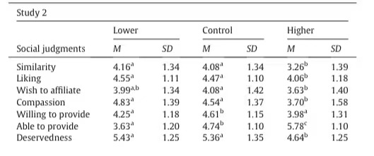
result
The manipulation check confirmed that, relative to the control condition (Mcontrol = 4.96, SD = 1.31), participants estimated John's position as higher in the higher class condition (Mhigher = 6.91, SD = 1.32), t(297) = 10.89, p b 0.001, d = 1.49, and lower in the lower class condition (Mlower = 3.80, SD = 1.21), t(297) = 6.33, p b 0.001, d = 0.92.
There were clear differences in target perception：means, standard deviations, and differences in social judgment per condition are summarized in Table 2
small correlations between social mindfulness and liking (r = 0.12, p = 0.044,), compassion (r = 0.12, p = 0.037), and willingness (r = 0.13, p = 0.031) and ability to provide resources (r = −0.13, p = 0.026). Correlations between social mindfulness and similarity (r = 0.10, p = 0.099), wish to affiliate (r = 0.05, p = 0.426), and deservedness (r = 0.09, p = 0.120) were non-significant, though similar in magnitude.

Slide 16
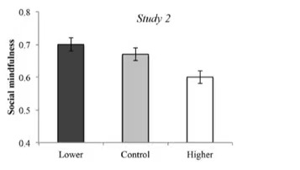
Social mindfulness ：social mindfulness varied across target descriptions, F(2, 297) = 3.75, p = 0.025, η2 = 0.03. Participants behaved less socially mindfully when imagining a higher versus a lower social class target, Mhigher = 0.60 (SD = 0.22), Mlower = 0.70 (SD = 0.25), t(297) = 2.66, p = 0.008, d = 0.43. The lower class condition did not differ significantly from control, Mcontrol = 0.67 (SD = 0.27), t(297) = 0.81, p = 0.416, d = 0.12; the higher class condition did so marginally, t(297) = 1.86, p = 0.064, d = 0.29.
Participant social class was largely independent of their prosocial across our measures，onlythe (positive) relationship between the SES-ladder and volunteering frequency approached significance.
Mediating effects of target perceptions.：we tested whether differences in perceived target similarity and deservedness mediated effects of target class on prosociality. ——two dummy coded variables
Neither similarity nor deservedness mediated the difference between high and low class,(lower and
Higher class relative to middle is same)

Slide 17
虚拟编码变量
在一元或者多元线性回归中，因变量是连续变量（如对某件商品的购买意愿），如果自变量是分类变量（商品的颜色）时（如1=红色，2=蓝色，3=绿色），将其直接带入回归方程中，假设自变量的回归系数显著，为0.5，此时的结果是无法解释的，该结果表明自变量每提高一个单位，因变量提高0.5个单位，但是此时自变量提高一个单位是没有意义的，在面对这种情况时，常用的做法是对分类自变量进行重新编码。
当自变量有n个水平时，需要构建n-1个虚拟变量，其中自变量的某一个水平为对照组，其在n-1个虚拟变量上的取值均为0，自变量的其他水平分别仅在1个虚拟变量上取值为1，其他n个虚拟变量取值为0

Slide 18
Study 3:adding middle class
Aim：how prosociality toward middle class targets；only providing participants with only their target’s position on the social class ladder.
Participants:450(238male,18~77years old,Mage=34.54,sd=11.49)
Social class and prosociality : limited measures of prosociality to SVO and social mindfulness.
Social mindfulness:1.only described target’s position on theSES-ladder and complemented by a picture of the ladder.
2.participants randomly assigned to one of three conditions(higher,lower,middle)
3.manipulation check:Participants then estimated the target's house- hold income, employment (yes/no, and if yes, desirability of the job), education level (college degree yes/no, and if yes, prestige of the university), the car he drives (old and beat up – new and fancy), and the neighborhood he lives in (not so nice – very nice)

Slide 19
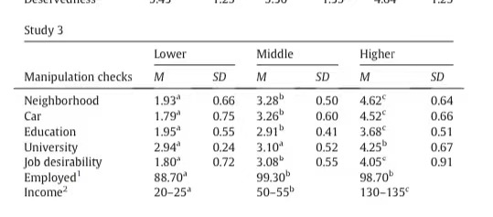
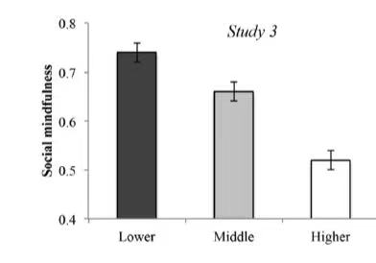
result
manipulation check :manipulation indeed conveyed the target’s social class in the intended manner.
Social mindfulness : t(447) = 2.95, p = 0.003, d = 0.33 for lower versus middle class targets; t(447) = 7.45, p< 0.001, d = 0.86, for lower versus higher class targets; and t(447) = 4.51, p<0.001, d = 0.54, for middle versus higher class targets.

Slide 20
和研究一的结果一样！被试和目标对象阶层没有交互作用，三个角度只支持公平角度，目标对象效应显著，被试阶层和亲社会没有关系
Result support fairness perspective.
No significant interaction between participants and target class
Effect of target class is same as study 1
No relationship between participant social class and prosociality

Slide 21
Study4 –mediation by stereotype content？
Aim： whether perceptions of warmth and competence mediate effects of target class on prosociality ； perceptions of social class can be linked to other categories（race） that may guide prosociality.
Participants；442（212female，19～74years old，Mage=35.43）
Social class and prosociality：same as study3
Study protocol：same as study 3
1.john ——white
2.rated john on six warmth related traits and six competence related trait
3.rated their similarity to john
4estimated john’s household , income, employment, education level , car quality and neighborhood.

Slide 22
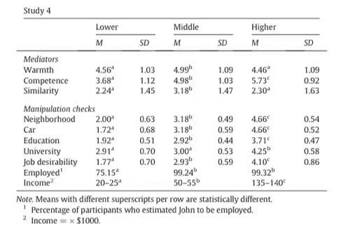
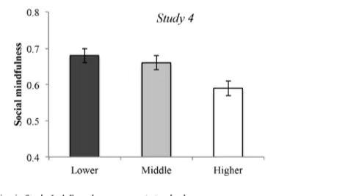
result
1.Manipulation check of target social class
2.Social mindfulness：Consistent with the previous three studies, participants behaved less prosocially when picturing a high class target (Mhigh = 0.59, SD = 0.27) relative to middle (Mmiddle = 0.66, SD = 0.26) or low class targets (Mlow = 0.68, SD = 0.25), F(2, 439) = 5.11, p = 0.006, η2 = 0.02. Whereas prosociality was lower for higher class targets relative to lower class targets, t(439) = 3.05, p = 0.002, d = 0.35, and middle class targets, t(439) = 2.35, p = 0.019, d = 0.27, prosociality toward lower and middle class targets did not differ, t(439) = 0.55, p = 0.583, d = 0.08
1.manipulation check：

Slide 23
3.交互作用，目标对象效应，被试阶层和亲社会关系都和之前研究结果一样。
4.Mediation effects of target perceptions：warmth and similarity ratings were positively related to social mindfulness (r = 0.17, p b 0.001, and r = 0.14, p = 0.004, respectively), while competence showed no relationship to social mindfulness (r = −0.04, p = 0.469) .
perceptions of similarity were highest for middle class targets, with no difference between low and high class targets. Similarly, perceptions of warmth were higher for middle class targets than for high or low class targets. In contrast, perceived competence was highest for high class targets and lowest for low class targets
no evidence that the target perceptions measured in this study mediated the difference between high and low class targets
results only suggest mediation via perceived warmth when differentiating between high and middle class targets

Slide 25
Meta-analysis
1the strongest effect on prosocial tendencies was found between high and low class targets.
2the only correlation that proved significant suggested more volunteering activities for higher class individuals

Slide 26
Discussion
1. Across four experiments, participants behaved less prosocially toward higher social class targets than toward lower, middle, or classwise unspecified targets.
2these results suggest that social class is indeed relevant to prosociality, but that target social class influences prosociality more than self social class.
3we advanced three broad perspectives as a guide to explain how target social class might influence prosocial behavior: Fairness, status, and similarity .only confirmation of the fairness perspective.
4People may perceive higher social class individuals as having unfair advantages in life or being snobbish and narcissistic
5. Higher social class individuals reported volunteering more than lower social class individuals, which is consistent with recent sociological findings

Slide 27
Limitation
1.Participants in our studies were interacting with hypothetical targets, without expecting to make acquaintance or have further interactions.
2. Future studies could add more information on target and may yield different results
3. not sample from the super-rich (who are un- likely to participate in MTurk studies) or the super-poor (who might not have access to computers).
4 samples are limited to the United States, and our data do not speak to the cross-cultural generalizability of our findings.

Slide 28
Thank you

Slide 29
Table1

