Slide 1
Influences of Emotional Information on Response Inhibition in Gaming Disorder: Behavioral and ERP Evidence from
Go/Nogo Task
汇报人：姜玲慧

Slide 2
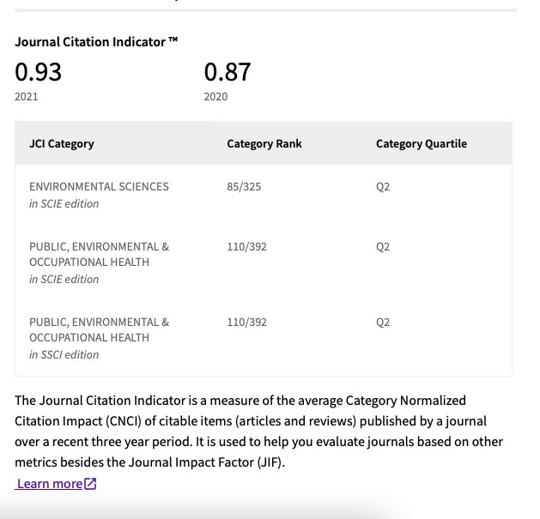
Come from
Notes:
国际环境研究与公共卫生杂志

Slide 3
目 录
COMPANY
01
Introduction
02
Materials and Methods
03
Results
04
Discussion
05
Conclusion
Notes:
我将从以下四个方面概括

Slide 4
1.1. GD and Response Inbihition
PART 01
1.2. GD and Emotion
1.3. Emotion and Task Relevance
Introduction
1.4. Hypotheses

Slide 5
1.1. GD and Response Inhibition
GD, a behavioral addication
Psychological characteristics： heightened arousal, craving, and tolerance
Psychological problems： such as increased aggression, impulsivity, and suicide attempts
The tripartite neurocognitive model
A hypoactive “reflection” system: a decrease in response inhibition ability.
A hypreactive “impulsive” system: play a trigger role in engagement in gaming behaviors.
An interoceptive system: exacerbates the dysfunction of the two systems.
Neurologically
Decreased response inhibition ability: abnormal amplitudes of N2 and P3
Go/nogo task: nogo stimuli induced larger N2 and P3 components than go stimuli
Notes:
反应系统：执行功能减弱
对于冲动性，也是之前有研究发现IGD，网络游戏成瘾存在决策障碍，倾向于即刻的满足，高冲动性触发

Slide 6
1.1. GD and Response Inhibition
Neurologically
Nogo-N2： represent conflict monitoring ability
Nogo-P3： reflects the completion of inhibitory processing
Hypothesize
response inhibition
abnormal activation of conflict monitoring and response evaluation stages
nogo-N2 and nogo-P3 amplitudes
Notes:
文章中对nogo-n2和nogo-p3也有一些解释，大家看文章就可以了这里就不做过多解释了
要注意的是与之相关的过程，冲突评估和抑制处理，
我们可以假设网络游戏成瘾的反应抑制受损可能会导致这两个过程不正常的激活，同时表现为nogo-n2和p3··

Slide 7
1.2. GD and Emotion
Psychological factors: such as emotional state
01 The tripartite neurocognitive model
The interoceptive syste: cognitive dysfunction of IGD.
02 Negative emotions
03 Neurological evidence
IGD: weaker dorsal anterior cingulate cortex activation and stronger insular activation to interfering angry facial stimuli
IAD: negative attentional bias
“rapid orientation towards and difficulty in releasing attention from negative emotional stimuli”
Previous Studies
Negative stimuli ---- GD
emotional information
inhibition control system
GD : more negative emotions
Notes:
有研究表示
内在感知系统会产生一种渴求的状态进而加重网络游戏障碍的认知障碍
游戏障碍患者，抑郁、焦虑、更弱的情绪管理能力等等
网络成瘾障碍IAD——借此推断我们的研究对象GD患者是否有类似的的注意偏向。
网络游戏障碍患者：比健康组，对愤怒表情的处理上，有更低的背侧前额皮层的激活，更高的岛叶激活——消极情绪信息影响脑区的激活
由此可推断，消极刺激对游戏障碍患者的影响主要是：一是在情绪信息处理中占主要地位、二是损害患者的反应抑制系统

Slide 8
1.3. Emotion and Task Relevance
a task-unrelated stimulus
Task-related emotional stimuli: improve behavioral performance (additional cognitive resources )
Task-unrelated emotional stimuli: impair behavioral performance (unrelated information competes)
Previous studies: an executive control paradigm
The dual competition model
individuals with high anxiety levels
impaired behavior is more likely to be observed
People with GD: higher levels of anxiety
Hypothesize:
perform worse inhibition ability in task-unrelated stimuli.
Notes:
之前的研究：以往的研究发现，在执行控制范式中，当任务相关和任务无关的情绪信息被使用时，神经激活会出现部分分离
双重竞争模型：情绪信息对执行控制系统的影响主要依赖于：情绪信息与任务的相关性、情绪信息的威胁程度
当与任务无关的刺激作用于有高焦虑水平的个体，···——可以推断任务相关性和情绪对行为表现可能有一定影响
由此我们可以推断任相关性与情绪对游戏障碍患者反应抑制的影响。
创新点：游戏障碍与任务相关与否，以及消极情绪信息联系起来

Slide 9
1.4. Hypotheses
Previous studies
Studies on response inhibition of GD mainly used neutral stimuli (e.g., letters and objects).
Couldn’t:
identify psychological factors affecting this process
directly determine behavioral processes in the context of social behavior
Notes:
联系之前对网络成瘾障碍（消极主义偏见）网络游戏障碍 低背侧前额皮层的激活——与控制有关）的研究、双重竞争模型的理论
心理状态可能是一种催化剂的角色，加重GD的反应抑制障碍，
社会行为情景下的行为过程——之前的研究用中性的刺激，但真实社会不是这样的
本研究的创新点
加入了心理状态--情绪的影响，以及将任务相关性与情绪信息的结合

Slide 10
1.4. Hypotheses
This study
three factor
2 (group: GD, control) × 2 (task: unrelated, related) × 2 (valence: negative, positive)
This effect might be stronger when processing task-unrelated emotional information rather than task-related information.
1
GD group shows impaired response inhibition.
2
This effect might be stronger when processing negative emotional stimuli than positive emotional stimuli.
Compared to the control group:
This effect might be stronger when processing task-unrelated emotional information rather than task-related information.
3
GD group shows differences in nogo-N2 and nogo-P3 amplitudes during response inhibition.
4
This effect might be stronger when processing negative emotional stimuli rather than positive emotional stimuli.
H1
H2
H2 GO
H3
H4
H4 P3
H3 P3

Slide 11
2.1. Participants
2.2. Procedure and Tasks
PART 02
2.3. Experimental Materials
Materials and Methods
2.4. Electrophysiological Recording and Preprocessing
2.5. Statistical Analysis

Slide 12
2.1. Participants
Online Questionnaire
the Internet Addiction Test (IAT)
the Internet Game Disorder Questionnaire (IGD)
a self-prepared online basic information questionnaire
sample size: 145 volunteers recruited online
Screening criteria:
GD group: 26 participants (14 males)
Internet addiction questionnaire: ≥ 50 points ,DSM-5: ≥ 5 criteria, and played games for >14 h per week for >1 year
Control group: 24 participants (12 males)
Internet addiction questionnaire: <50 points, DSM-5: ≤ 4 criteria, and played games for <2 h per week
normal vision or corrected vision and were right-handed

Slide 13
2.2. Procedure and Tasks
Procedure
Write informed consent, wear an EEG cap;
press (or not press) keys according to the instructions;
E-prime 2.0 on a CRT monitor (a refresh rate of 60 Hz).
1
An emotional face go/nogo task: identify the gender or emotional valence of faces, which was the task-unrelated and task-related processing of emotional information.
Each participant completed both the unrelated and related conditions.
2
3
The experimental session lasted for 60–70 min, and the participants were compensated with 60 CNY after finishing the experiment.
Notes:
签知情同意书，带脑电帽等等，就不细说了
主要是这个情绪化面部的go/nogo任务
任务不相关的情绪信息处理与。。。

Slide 14
2.2.1. Task-Unrelated Condition
Identify the gender of the faces and ignore their emotions;
the emotional information of the faces was task-unrelated
(1) Divided into two blocks:
press a button when they saw a female face (go trial) and not to press the button when they saw a male face (nogo trial)
press a button when they saw a male face (go trial) and not to press the button when they saw a female face (nogo trial)
(2) 240 trials per block, including 168 go trials (70%) and 72 nogo trials (30%)
(3) Go and nogo trials were pseudo-random, and the go trials always preceded the nogo trials to elicit dominant motor responses and apparent conflicts during response suppression.
(4) Instructions: press or not press the “J” key with their right hand, depending on the gender of the face.
Notes:
在之后的实验设计上我们也可以以这个为参照

Slide 15
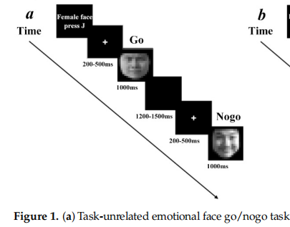
2.2.1. Task-Unrelated Condition
Identify the gender of the faces and ignore their emotions;
the emotional information of the faces was task-unrelated
Notes:
图上以女性脸为go试次的block
注视点，要求按键的go试次，空白黑色屏幕，注视点，不按键的go试次

Slide 16
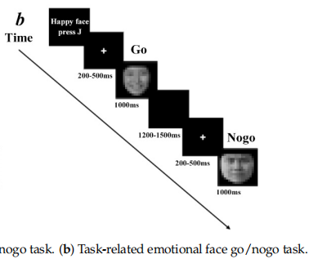
2.2.1. Task-Related Condition
Concentrated on the emotional information on the faces;
the emotional information was task-related
press a button when they saw a happy face (go trial) and not to press it when they saw an angry face (nogo trial)
press a button when they saw an angry face (go trial) and not to press it when they saw a happy face (nogo trial)
Notes:
根据面部表情，开心或者生气，判断按键或不按键
图中是看到高兴的脸时按键的block

Slide 17
2.3. Experimental Materials
2.3.1. Emotional Face Materials
40 happy faces and 40 angry faces selected from the Chinese Facial
Affective Picture System
20 male faces and 20 female faces were used in each emotional valence
Notes:
中国面部情感图片系统
之后的设计也可以从这种比较权威的、应用比较多的数据库，选择材料

Slide 18
2.3. Experimental Materials
2.3.2. Measures
(1) Grouping:
The Internet Gaming Disorder Questionnaire;
Internet Addiction Test
(2) Levels of depression,
anxiety, and impulsivity:
The Beck Depression Inventory , the Self-Rating Anxiety Scale,
the Barratt Impulsiveness Scale
(3) Exclude participants with alcohol addiction and smoking addiction:
The Alcohol Use Disorder IdentificationTest,
Fagerstrom Test for Nicotine Dependence

Slide 19
2.4. Electrophysiological Recording and Preprocessing
All inter-electrode impedance was maintained below 5 KΩ, and the sampling rate was 500 Hz.
1. Brain Electrical Activity
01
02
03
TOOL
REFERENCE
PLACE
64 scalp sites，
tin electrodes mounted in an elastic cap
a linked mastoid (LM)
below the right eye and infra-orbitally at the left eye to record vertical electrooculogram (VEOG) and horizontal electrooculogram (HEOG)
Notes:
记录脑电活动内容，
电极阻抗小于5千欧，是在我们的实验中也要满足的条件

Slide 20
2.4. Electrophysiological Recording and Preprocessing
Epochs with amplitudes over ±100 µV at any site were excluded from averaging.
2. EEG Data
01
02
03
TOOL
ANALYSIS
SEGMENT
MATLAB R2014a (8.3.0.532),
the EEGLAB toolbox (v14.1.1)
Independent component analysis (ICA)
Spanning 200 ms prior to each picture onset to1000 ms after the presentation of the face stimuli.
200 ms pre-stimulus: the baseline to align the ERP amplitude
Notes:
眼部伪影和头部运动，从数据中移除

Slide 21
2.4. Electrophysiological Recording and Preprocessing
3. Time Windows
VARY
01
02
03
PREVIOUS
THIS
SITE
Nogo-N2: 200–380 ms, 150–400 ms, 200–350 ms, and 240–300 ms
Nogo-P3: 300–500 ms, 350–700 ms, and 350–550ms
Nogo-N2: 280 to 380 ms
Nogo-P3: 380 to 600 ms
five fronto-central sites (F3, F4, Fz, FC3, FC4), five central sites (CZ, C1, C2, C3, C4), and four centro-parietal sites (CP1, CP2, CP3, CP4)

Slide 22
2.5. Statistical Analysis
For the behavioral analysis
For the ERP analysis
The statistical analysis
group (GD/control) , task (unrelated/related), emotional valence (negative/positive)
Dependent variables: the accuracies of the nogo/go trials and reaction times of go trials.
a three-way repeated-measures analysis of variance (ANOVA)
group (GD/control) , task (unrelated/related), emotional valence (negative/ positive), electrode point (14 sites)
Dependent variables: nogo-N2 and nogo-P3 amplitudes at 14 sites
a four-way repeated-measures analysis of variance (ANOVA)
SPSS Version 25.0

Slide 23
3.1. Descriptive Results
PART 03
Results
3.2. Behavioral Results
3.3. ERP Results

Slide 24
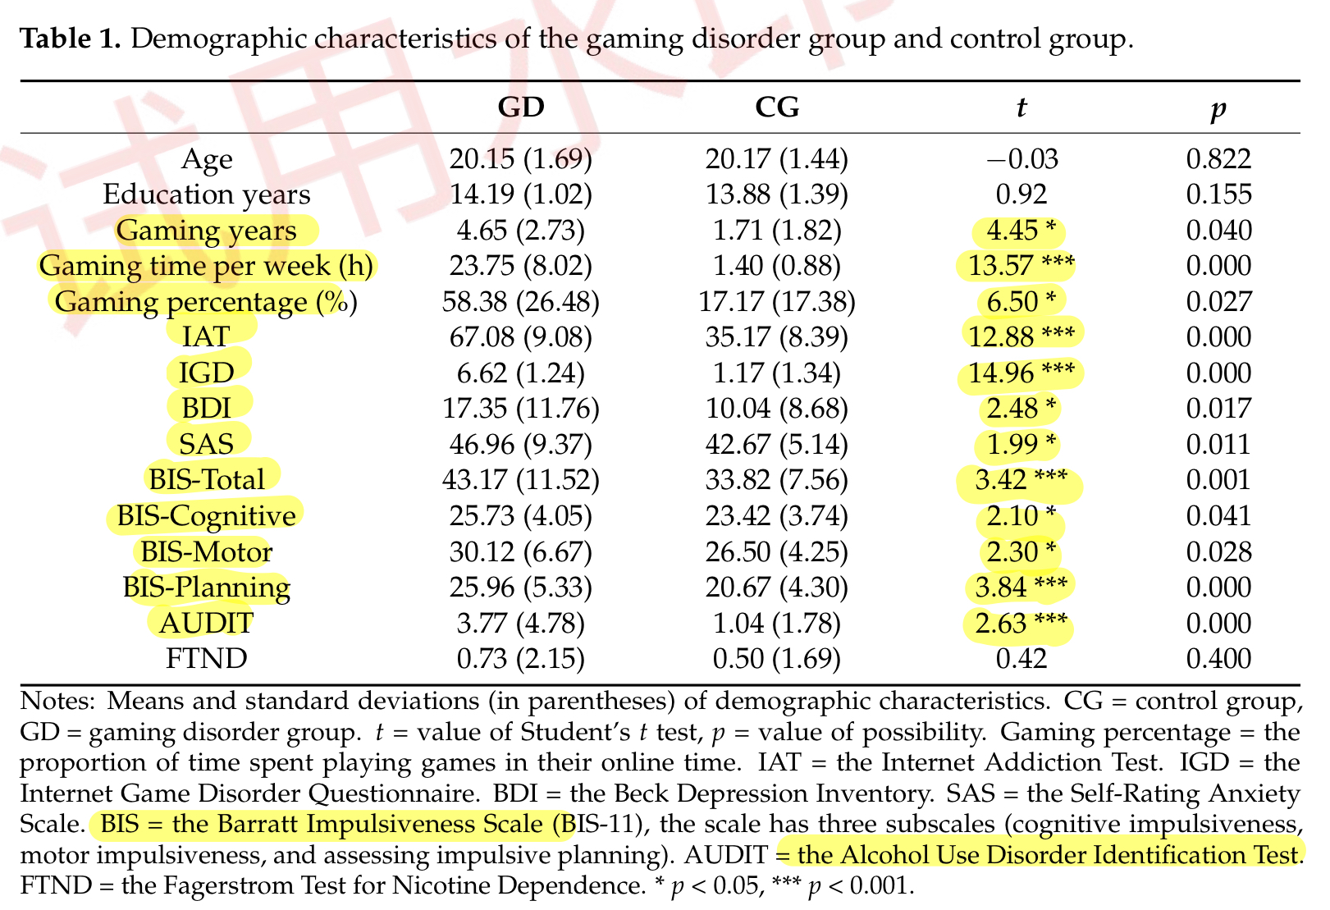
3.1. Descriptive Results
Notes:
玩游戏时间显著多
网络成瘾、网络游戏障碍测试分数显著高于控制组
抑郁、焦虑、冲动性评分也显著高于控制组
酒精使用障碍测试中，游戏障碍组高于控制组，尼古丁成瘾测试上不显著

Slide 25
3.1. Descriptive Results
Notes:
简单的看到他们的平均数、标准差的数据，没有表明显著性，不以这个为重点

Slide 26
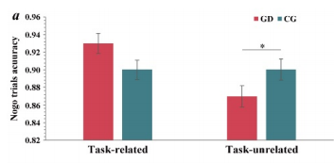
3.2. Behavioral Results
3.2.1. Response Inhibition in Nogo Trials
The main effect of the task √
The main effect of the group ×
The task × group interaction √
H1 √
(a) Task × group interaction
Simple effect analysis
H
Notes:
通过分析，我们发现任务的主效应显著
游戏障碍组在任务相关与任务不相关条件下的准确性明显不同
在任务不相关条件下，游戏障碍组在nogo试次的准确性显著低于控制组

Slide 27
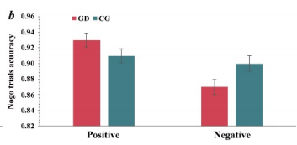
3.2. Behavioral Results
3.2.1. Response Inhibition in Nogo Trials
4. The main effect of emotional valence √
5. The valence × group interaction √
H2 √
(b) Valence × group interaction
Simple effect analysis
(M = 0.90, SD = 0.01, p = 0.06)
H
dis.
Notes:
边缘显著
另一个视角看，在游戏障碍组，积极情绪信息的nogo试次正确率显著高于消极情绪信息下的正确率(M = 0.87, SD = 0.01, p < 0.001)
因此可以说消极情绪信息对游戏障碍患者的反应抑制有显著的影响相比于积极情绪信息，消极情绪下的反应抑制受损更大。验证了假设2

Slide 28
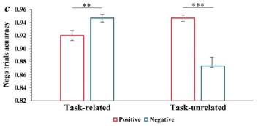
3.2. Behavioral Results
3.2.1. Response Inhibition in Nogo Trials
Additionally:
The task × valence interaction √
The task × valence × group interaction ×
(c) Task × valence interaction
Simple effect analysis
previous
Notes:
任务不相关时，积极情绪信息的正确率显著高于消极情绪的，可以进一步验证之前的研究：任务不相关的刺激作用于焦虑水平较高的个体，该个体可能会表现出更多的行为受损
任务相关时，消极情绪信息正确率更高，表现出，任务相关时，个体注意力更集中于任务，相比于积极情绪，对消极情绪有更好的抑制，作出更多的正确反应。
验证之前的研究

Slide 29
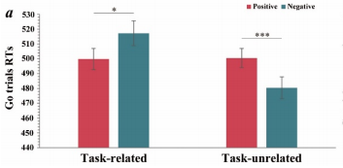
3.2. Behavioral Results
3.2.2. Response in Go Trials
Additionally:
The main effect of the task √
The task × valence interaction √
(a) Task × valence interaction on go trials RTs
Simple effect analysis
cognitive processing
Notes:
任务相关的反应时显著高于不相关的，这与我们的认知加工过程有关，相关时我们可能要经过更多加工分析过程
任务相关条件下：积极情绪信息的go反应时显著低于消极情绪信息反应时，表现出我们在有情绪有关的情境中，相比于消极情绪来说加工积极情绪更快
任务不相关条件下：积极情绪的反应时显著长于消极情绪
可以推断在任务不相关条件下，情绪信息可能会损害游戏障碍患者的抑制行为
任务相关性、情绪都会影响go试验的反应时，都会影响人的行为反应、反应抑制能力

Slide 30
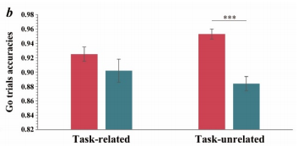
3.2. Behavioral Results
3.2.2. Response in Go Trials
Additionally:
The main effect of the valence √
The task × valence interaction √
(b) Task × valence interaction on go trials accuracies
Simple effect analysis
H
Notes:
情绪信息不同，go试验的准确率不同，积极情绪高于消极情绪
任务不相关时，积极情绪信息的准确性显著高于消极情绪的
=任务不相关时，消极情绪下反应抑制能力受损
部分验证

Slide 31
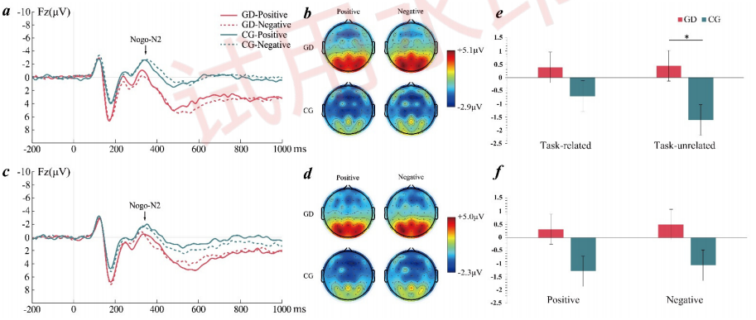
3.3. ERP Results
3.3.1. Results of Nogo-N2

Slide 32
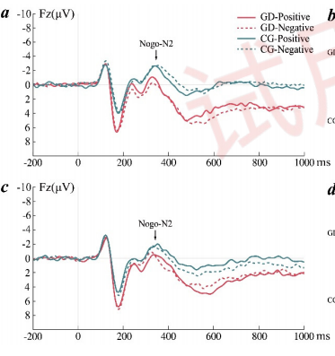
3.3. ERP Results
3.3.1. Results of Nogo-N2
Averaged ERPs at Fz
The main effect of the task √
Notes:
上面是任务不相关，下面是任务相关
任务不相关的N2的振幅显著比任务相关高

Slide 33
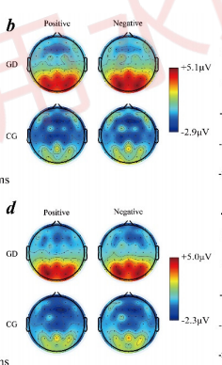
3.3. ERP Results
3.3.1. Results of Nogo-N2
Topographic maps of nogo-N2
2. The main effect of the electrode point √
Notes:
上面是任务不相关，下面是任务相关

Slide 34
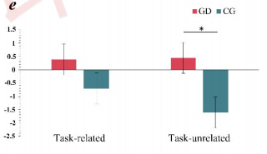
3.3. ERP Results
3.3.1. Results of Nogo-N2
Task × group interaction on
nogo-N2 amplitudes
3. The main effect of the group ×
4. The task × group interaction √
H3 √
H
dis.
Notes:
组的主效应：GD 与CD差异不大，不显著
任务不相关时，GD组的N2振幅显著低于CD组

Slide 35
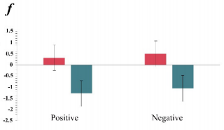
3.3. ERP Results
3.3.1. Results of Nogo-N2
Valence × group interaction on nogo-N2 amplitudes
5. The main effect of the valence ×
6. The valence × group interaction×
H4 ×
H
Notes:
情绪的主效应不显著，
无论是游戏障碍组还是控制组，在积极情绪和消极情绪信息两种水平下，振幅差异不大

Slide 36
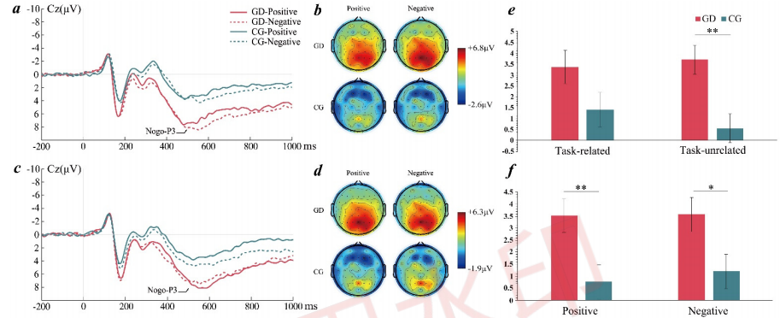
3.3. ERP Results
3.3.2. Results of Nogo-P3

Slide 37
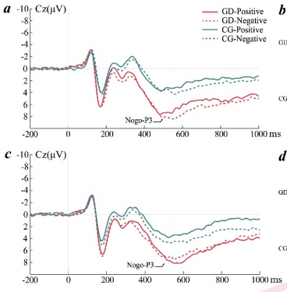
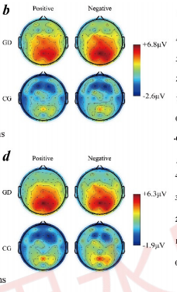
3.3. ERP Results
3.3.2. Results of Nogo-P3
Averaged ERPs at Cz
Topographic maps of nogo-P3
The main effect of the task ×
The main effect of the electrode point √
Notes:
上：不相关，下：相关

Slide 38
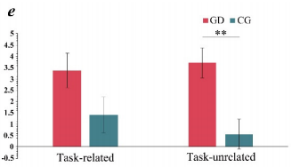
3.3. ERP Results
3.3.2. Results of Nogo-P3
Task × group interaction on
nogo-P3 amplitudes
3. The main effect of the group √
4. The task × group interaction √
H3 √
H
dis.
Notes:
无论在任务相关还是任务不相关，GD 都高于CD
任务相关与任务不相关差异不显著
在任务不相关时，GD 比CD 显著高

Slide 39
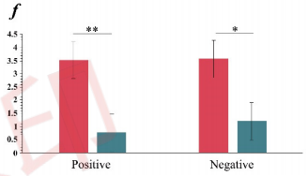
3.3. ERP Results
3.3.2. Results of Nogo-P3
Valence × group interaction on nogo-P3 amplitudes
5. The main effect of the valence ×
6. The valence × group interaction ×
H4 ×
H
Notes:
两种条件下，GD 都高于CD
无论是GD 还是CD组，在积极情绪和消极情绪的信息下，振幅差异不大
组别效应不会因为情绪信息的不同而变化，两者没有交互效应

Slide 40
4.1. Task Relevance and Response
Inhibition in GD
PART 04
4.2. Emotional Valenve and Response
Inhibition in GD
Discussion
4.3. Contributions and Limitations

Slide 41
4. Discussion
4.1. Task Relevance and Response Inhibition in GD
nogo-n2
Note: This is different from the results of a previous study
nogo-p3
Manifested as enhanced nogo-N2 and reduced nogo-P3 amplitudes in excessive social networking site (SNS) users compared with non-excessive users.
The reason:
used addiction-related stimuli (SNS logos)/ task-unrelated stimuli (face images)
more likely to attract the attention of Internet addicts
lead to enhanced activation of conflict monitoring and reduced activation of response evaluation
Notes:
任务相关性和游戏障碍中的反应抑制在之前的结果中有解释，
任务相关性会影响游戏障碍患者的反应抑制能力，并表现出nogo-n2和nogo-p3振幅的不同
值得注意的是note
我们的研究结果是：相比控制组，更小的nogo-n2和更大的nogo-p3也就是较弱的冲突检测，较强的反应评估

Slide 42
4. Discussion
4.2. Emotional Valence and Response Inhibition in GD
The dual competition model
The dual competition model indicates that emotional stimuli with higher threat levels will reduce behavior performance, and behavior performance impairment is more frequently observed in individuals with high anxiety levels.
this study
Notes:
对于情绪效价和游戏障碍患者的反应抑制，补充一个有关情绪和行为表现关系的理论模型，有助于我们解释这个研究，
本研究，游戏障碍患者表现出：有较多消极情绪，行为表现差，反应抑制能力受损
与模型所说一致。

Slide 43
4. Discussion
4.2. Emotional Valence and Response Inhibition in GD
This study
Difference:
1. the main effect of the group:
in nogo-N2 amplitudes ×
in nogo-P3 amplitudes √
2. the valence × group interaction：
in the behavioral results ：in the task-related condition√
in the ERP results ：more significant tendency
The valence of faces relies more on visual perception which requires conscious intervention, while valence in the task-unrelated condition may not fully show its effect.
Notes:
nogo-N2 ：冲突监测，需要意识干预，,情绪效价需要通过视觉感知——意识，之前的研究只是将情绪作为唯一的被试间变量，也就是说作为在任务相关的条件下出现，有意识地参与
在任务无关条件下，忽略情绪效价，没有意识参与，N2振幅在两组比较中不显著
nogo-P3： 反应抑制的完成

Slide 44
4. Discussion
4.3. Contributions and Limitations
Contributions
(1) Provides behavioral and neural evidence for impaired response inhibition in individuals with GD under conditions of different emotional information.
(2) Enrich the interaction theory between cognition and emotion in GD and provide evidence for the connection between the interoceptive system and executive systems in the tripartite model of GD.
(3) Provides a theoretical basis for GD intervention. ( behavior modification, psychological factors, such as the principle of cognitive behavioral therapy )

Slide 45
4. Discussion
4.3. Contributions and Limitations
Limitations
(1) The relatively small sample size
some of the results in the study were not very pronounced [larger samples]
(2) The participants: a self-selected online procedure
a bias to study altered online behaviors such as GD. [recruit clinically diagnosed participants]
(3) Did not control the gaming condition of participants prior to the experiment
playing internet games 48 h before an experiment affects the results. [ the gaming condition prior to the experiment as a control variable]

Slide 46
4. Discussion
4.3. Contributions and Limitations
Limitations
(4) Faces are just one possible emotional cue
response inhibition -- many potential processes [add a measure of emotional engagement, such as an autonomic marker or self-reported trial-by-trial ratings]
(5) Only compared positive and negative faces and did not include neutral faces.
[include neutral faces, negative faces: ＋indicating fear or disgust.]

Slide 47
PART 05
Conclusions

Slide 48
5. Conclusions
The findings showed that ...
01
The response inhibition of individuals with GD was regulated by task relevance and emotional valence.
02
The response inhibition ability of individuals with GD was weakened when processing task-unrelated or negative information.
03
Individuals with GD: more impulsive responses, failures of behavioral inhibition, and weakened conflict control
leading to: more consumption of cognitive resources to complete response suppression
Notes:
更少的n2，更多的p3

Slide 49
5. Conclusions
Meaning ...
01
Provided evidence for the impaired response inhibition of GD individuals from the perspective of the interaction theory between cognition and emotion.
02
Provided more detailed information
for interventions for GD.

Slide 50
感谢您的观看!

