Slide 1
Brief Compassion Training Reduces Intergroup Psychological Barriers:
An Experimental Study
The Author(s), under exclusive licence to Springer Science+Business Media, LLC, part of Springer Nature 2023
汇报人：蓝子清

Slide 2
目录
contents
Introduction
Method
Results
Discussion
Limitations and Future Research
5

Slide 3
Introduction
Prior researches
The intergroup emotions theory→negative intergroup emotions and attitudes were often the results of negative outgroup appraisals, which could lead to avoidance or aggressive behaviors towards outgroup members, perpetuating intergroup conflicts.
compassion was positively associated with prosocial emotions (e.g., warmth, empathy, sympathy), attitudes (e.g., reduce prejudice, increase acceptance), and behaviors (e.g., helpfulness, volunteerism)

Slide 4
Introduction
Prior researches
compassion could be conditional→compassionate feelings and responses were often minimized towards outgroups or people with salient value differences
brief compassion training has been found to be effective in improving feelings and attitudes towards political partisans in the USA, reducing prejudice towards people experiencing homelessness, and inducing altruistic behaviors towards victims of a redistribution game

Slide 5
Introduction
objective:investigate whether an online brief compassion training could reduce emotional and attitudinal psychological barriers to engage with outgroups, and facilitate more favorable behavioral responses towards multiple outgroups in HK.
①ethnic minorities,
②Mainland immigrants,
③people with opposite political views

Slide 6
Introduction
hypothesies:
participants who receive a brief compassion training would have:
1. more favorable outgroup emotions, attitudes, social distance, and donation behavior;and
2. similar emotional, attitudinal, and behavioral changes towards three outgroups.

Slide 7
Method
Participants
criteria:
(1) could read Chinese and understand Cantonese;
(2) were 18 years of age or older;
(3) had no vision or hearing impairment;
(4) had no technical or Internet connection problem during the experiment;
(5) agreed to the informed consent and debriefing provided,
(6) passed the validity check on attentiveness.
exclusion criteria :
(1) individuals who indicated no political stance;
(2) individuals who self-reported as an ethnic minority or a Mainland immigrant

Slide 8
Method
Participants
Three social groups in Hong Kong:
(1)ethnic minorities
(2)Mainland immigrants
(3)people with opposing political views.
These groups face discrimination due to visible differences in physical characteristics, less obvious but noticeable differences in mother tongue , and ideological differences respectively.

Slide 9
Method
Participants
255eligible participants →1:1
32 participants were excluded due to
(1) withdrew from the study (n = 15)
(2) had technical or Internet connection problems (n = 5)
(3) failed validity check on attentiveness (n = 12).
finally: 223 participants.
technical issue in the platform→omit 26.50% participants in the pre-experiment questionnaire →165 ethnic minorities, 166 Mainland immigrants, 165 people with opposite political views (Fig. 1).

Slide 10
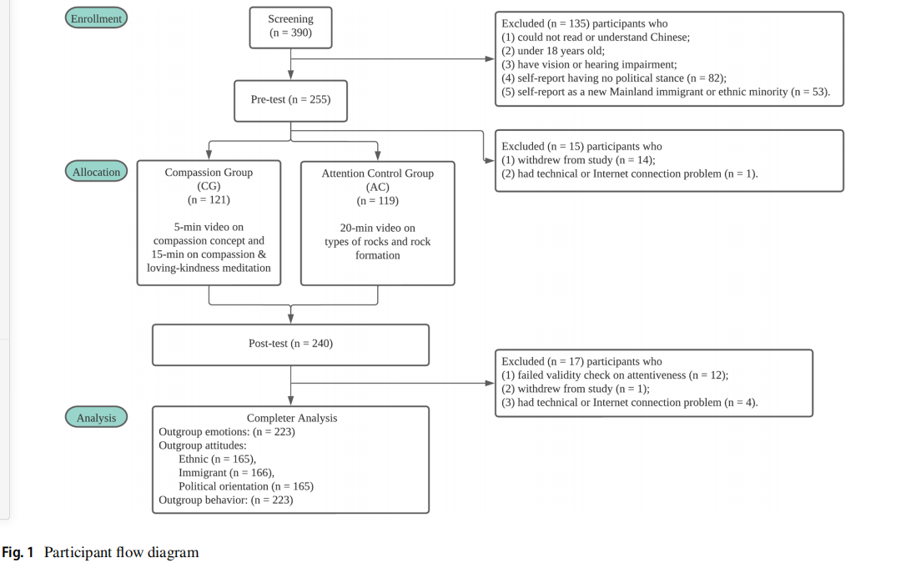
Fig. 1 Participant flow diagram

Slide 11
Procedure
1.Participants were told this study aimed to investigate the relationship between attention and interpersonal relationships.
The actual purpose of the study was concealed at the outset to avoid changing participants’ attitudes and behavior which might cause participants’ bias.
2.consent form and pre-experiment questionnaire.2 weeks
3.online under the live video monitoring of an experimenter.

Slide 12
Procedure
4.watched the video of the randomly assigned experimental condition.
5.post-experiment questionnaire and questions for validating their level of attentiveness.
6.debriefed the participants
7.223 participants were given HK$50 cash
8.79.80% participants (n = 178) accepted the cash compensation.

Slide 13
compassion condition:
(1)a 5-min video introduction on the definition of compassion based on the five dimensions of compassion and short stories about compassion.
(2)a 15-min video on guided compassion practice,which centers on recognizing the suffering of all people and cultivating compassion towards the self, loved ones, strangers, and difficult persons.
(refer to Fig. 2 for sample screenshots).

Slide 14
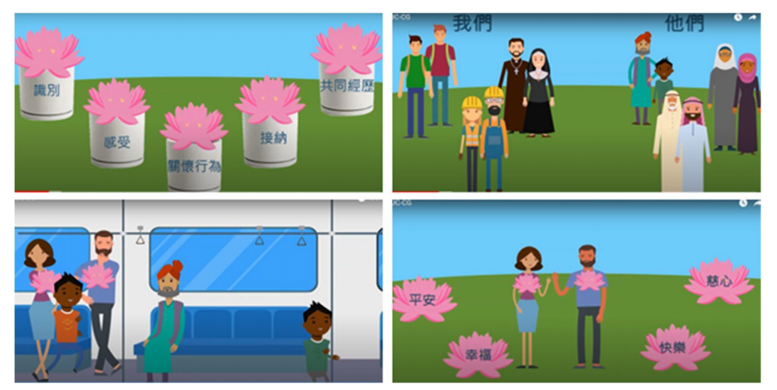
Fig. 2 Sample screenshots of compassion induction video introducing the components of compassion

Slide 15
active control condition:
a 20-min video about different types of rocks and their formation, which were neutral content and unrelated to compassion.
(refer to Fig. 3 for sample screenshots).
Both scripts had a comparable number of words and duration, and both scripts were recorded by the same person with a similar tone and speed.

Slide 16
Fig. 3 Sample screenshots of attention control video introducing different types of rocks and rock formation

Slide 17
Measures
Data on compassion, emotions, attitudes, and social distance were collected in the pre- and post-experiment questionnaires.
Donation behavior was only collected after the experiment.
All measures were presented in Chinese.
Demographics and Experience with Outgroups
Compassion:The Sussex-Oxford Compassion for Others Scale (SOCS-O)
Outgroup Emotions:The 8-item Negative Emotions Scale
Outgroup Attitudes:The Negative Outgroup Attitudes scale
Social Distance:The Social Distancing Scale
Donation to Outgroups：The donation behavior was adapted from Brienza et al. (2021).

Slide 18
Measures
Attentiveness Validation:
(1)Compassion condition:participants were asked to briefly describe the things learned after watching the compassion induction.
(2)Control condition:participants were asked to copy a string of numbers in a textbox and answer two simple questions related to types of rocks.
Participants who provided irrelevant points or wrong answers were excluded.

Slide 19
Data Analyses
dependent variables :the manipulation check (compassion induction) and the experimental outcome measures (negative outgroup emotions, negative outgroup attitudes, social distance, and donation behavior) towards three outgroups (ethnic minority, Mainland immigrants, people with opposite political views).
independent variables ：
（1）the experimental conditions (compassion, active control),
（2）timepoint of the measurement (pre-experiment, post-experiment)
（3）the interaction between these variables.

Slide 20
Results
Baseline Comparisons
The baseline intergroup responses towards specific outgroups varied.
The negative emotions, negative attitudes, and social distance：political partisans＞Mainland immigrants＞ethnic minorities
The total sample’s average scores towards ethnic minorities were on the low end for
negative emotions (M = 2.20 (pre) and M = 2.03 (post) out of 7)
negative attitudes (M = 2.72 (pre) and M = 2.70 (post) out of 9)
social distance (M = 1.47 (pre) and M = 1.35 (post) out of 4)
indicating a generally low level of prejudice towards ethnic minorities.

Slide 21
Manipulation Check
The effect sizes of scaled variables were analyzed (Morris, 2008). A significant experimental conditions × timepoint interaction on the total compassion score (F(1,223) = 6.24, p = 0.01, d = 0.26) was found.
Post hoc analysis showed a significant increase in the compassion condition (Mean Difference = 0.57, p = 0.004) but not in the control condition.

Slide 22
Manipulation Check
recognize： (F(1,223) = 4.33, p = 0.04, d = 0.22)
post-hoc analysis only significant in the compassion condition (mean difference = 0.13, p = 0.02).
feel：post hoc analysis showed that the changes were not significant in both experimental conditions.
No significant result：understanding the universality of suffering
tolerating uncomfortable feelings related to suffering
being motivated to alleviate others’ suffering.

Slide 24
Effects of Compassion Induction on Outgroup Emotions, Attitudes, and Behaviors
A significant experimental conditions × timepoint interaction was found for negative outgroup emotions (F(1,223) = 4.32, p = 0.039, d = 0.22)
negative outgroup attitudes (F(1,222) = 4.92, p = 0.03, d = 0.24)
social distance (F(1,223) = 4.38, p = 0.04, d = 0.21),
but not for donation behavior (X²(1) = 1.13, p = 0.29).

Slide 25
Effects of Compassion Induction on Outgroup Emotions, Attitudes, and Behaviors
The experimental effect of compassion induction differed in responses towards specific outgroups.
ethnic minorities：no significant experimental conditions × timepoint interaction was found for any intergroup response outcomes.

Slide 26
Effects of Compassion Induction on Outgroup Emotions, Attitudes, and Behaviors
people with opposite political views：
a significant experimental conditions × timepoint interaction was found for outgroup emotions (F(1,223) = 4.63, p = 0.03, d = 0.26), but the results of other outgroup responses were not significant.

Slide 27
Effects of Compassion Induction on Outgroup Emotions, Attitudes, and Behaviors
people with opposite political views
Post hoc analysis showed a significant reduction in negative outgroup emotions in the compassion condition (mean difference = −0.32, p = 0.003) but not in the control condition.
To further analyze the effect of compassion on emotional attributes towards political partisans, repeated measures ANOVA was used.
reduction in fear (F(1,113) = 5.61, p = 0.02) and disgust (F(1,113) = 5.15, p = 0.03),
but not anger (F(1,113) = 3.84, p = 0.052), were significant.

Slide 28
Effects of Compassion Induction on Outgroup Emotions, Attitudes, and Behaviors
Mainland immigrants：a significant experimental conditions × timepoint interaction was found for negative outgroup emotions (F(1,223) = 6.20, p = 0.01, d = 0.26), negative outgroup attitudes (F(1,173) = 12.60, p < 0.001, d = 0.40), and social distance (F(1,223) = 7.07, p = 0.01, d = 0.28).

Slide 29
Effects of Compassion Induction on Outgroup Emotions, Attitudes, and Behaviors
Mainland immigrants：
Post-hoc analysis：
compassion condition showed a significant reduction of negative outgroup emotions (mean difference = −0.22, p = 0.02), negative outgroup attitudes (mean difference = −0.29, p = 0.03), and social distance (mean difference = −0.30, p < .001) towards immigrants, but the change in donation behavior was nonsignificant.
control condition showed an increase in negative outgroup attitudes (mean difference = 0.38, p = 0.004) towards immigrants. This result could contribute to a relatively larger effect size of the attitudinal outcome when compared with the emotional and behavioral outcomes.

Slide 30
Discussion
1.Brief online compassion induction could reduce negative emotions, attitudes, and social distance, but not donation behavior towards outgroups. The results of intergroup responses towards specific outgroups were inconsistent.
2.A small reduction in negative emotions towards people holding opposite political views. No effect was found in intergroup responses towards ethnic minorities.
PPT模板下载：www.1ppt.com/moban/ 行业PPT模板：www.1ppt.com/hangye/
节日PPT模板：www.1ppt.com/jieri/ PPT素材下载：www.1ppt.com/sucai/
PPT背景图片：www.1ppt.com/beijing/ PPT图表下载：www.1ppt.com/tubiao/
优秀PPT下载：www.1ppt.com/xiazai/ PPT教程： www.1ppt.com/powerpoint/
Word教程： www.1ppt.com/word/ Excel教程：www.1ppt.com/excel/
资料下载：www.1ppt.com/ziliao/ PPT课件下载：www.1ppt.com/kejian/
范文下载：www.1ppt.com/fanwen/ 试卷下载：www.1ppt.com/shiti/
教案下载：www.1ppt.com/jiaoan/
字体下载：www.1ppt.com/ziti/

Slide 31
Discussion
3.20-min online compassion induction is effective in increasing participants’ level of compassion→ total compassion score（可以从table2看出）
4.could not empirically measure how cognitive appraisals influence intergroup emotions, as we did not assess participants’ cognitive appraisals of specific outgroups.
PPT模板下载：www.1ppt.com/moban/ 行业PPT模板：www.1ppt.com/hangye/
节日PPT模板：www.1ppt.com/jieri/ PPT素材下载：www.1ppt.com/sucai/
PPT背景图片：www.1ppt.com/beijing/ PPT图表下载：www.1ppt.com/tubiao/
优秀PPT下载：www.1ppt.com/xiazai/ PPT教程： www.1ppt.com/powerpoint/
Word教程： www.1ppt.com/word/ Excel教程：www.1ppt.com/excel/
资料下载：www.1ppt.com/ziliao/ PPT课件下载：www.1ppt.com/kejian/
范文下载：www.1ppt.com/fanwen/ 试卷下载：www.1ppt.com/shiti/
教案下载：www.1ppt.com/jiaoan/
字体下载：www.1ppt.com/ziti/

Slide 32
Discussion
5. ethnic minorities：The non-significant effect observed →participants’lower prejudice towards ethnic minorities.
lowest baseline scores
lower socioeconomic status in HK
a higher perceived deservingness to help, rendering lower negative intergroup emotions and attitudes towards them。
6.People with opposite political views:reducing negative outgroup emotions, we further analyzed the emotional attributes. Results revealed that the reductions in fear and disgust towards political partisans were significant, whereas anger was not.
PPT模板下载：www.1ppt.com/moban/ 行业PPT模板：www.1ppt.com/hangye/
节日PPT模板：www.1ppt.com/jieri/ PPT素材下载：www.1ppt.com/sucai/
PPT背景图片：www.1ppt.com/beijing/ PPT图表下载：www.1ppt.com/tubiao/
优秀PPT下载：www.1ppt.com/xiazai/ PPT教程： www.1ppt.com/powerpoint/
Word教程： www.1ppt.com/word/ Excel教程：www.1ppt.com/excel/
资料下载：www.1ppt.com/ziliao/ PPT课件下载：www.1ppt.com/kejian/
范文下载：www.1ppt.com/fanwen/ 试卷下载：www.1ppt.com/shiti/
教案下载：www.1ppt.com/jiaoan/
字体下载：www.1ppt.com/ziti/

Slide 33
Discussion
7.Mainland immigrants:small improvements in outgroup emotions, attitudes, and social distance were observed, but not for donation behavior.
8.a generic and brief compassion induction could reduce prejudice towards multiple outgroups with different characteristics and levels of prejudice.
PPT模板下载：www.1ppt.com/moban/ 行业PPT模板：www.1ppt.com/hangye/
节日PPT模板：www.1ppt.com/jieri/ PPT素材下载：www.1ppt.com/sucai/
PPT背景图片：www.1ppt.com/beijing/ PPT图表下载：www.1ppt.com/tubiao/
优秀PPT下载：www.1ppt.com/xiazai/ PPT教程： www.1ppt.com/powerpoint/
Word教程： www.1ppt.com/word/ Excel教程：www.1ppt.com/excel/
资料下载：www.1ppt.com/ziliao/ PPT课件下载：www.1ppt.com/kejian/
范文下载：www.1ppt.com/fanwen/ 试卷下载：www.1ppt.com/shiti/
教案下载：www.1ppt.com/jiaoan/
字体下载：www.1ppt.com/ziti/

Slide 34
Limitations and Future Research
1.in the total compassion score, only one of the five compassion components showed a significant increase. a metaphorical story to teach the concept of awareness of suffering.
2. use a Caucasian character in the attention control condition video may have unintentionally elicited negative implicit bias towards ethnic minorities→minimize the potential implicit biases in research design.
PPT模板下载：www.1ppt.com/moban/ 行业PPT模板：www.1ppt.com/hangye/
节日PPT模板：www.1ppt.com/jieri/ PPT素材下载：www.1ppt.com/sucai/
PPT背景图片：www.1ppt.com/beijing/ PPT图表下载：www.1ppt.com/tubiao/
优秀PPT下载：www.1ppt.com/xiazai/ PPT教程： www.1ppt.com/powerpoint/
Word教程： www.1ppt.com/word/ Excel教程：www.1ppt.com/excel/
资料下载：www.1ppt.com/ziliao/ PPT课件下载：www.1ppt.com/kejian/
范文下载：www.1ppt.com/fanwen/ 试卷下载：www.1ppt.com/shiti/
教案下载：www.1ppt.com/jiaoan/
字体下载：www.1ppt.com/ziti/

Slide 35
Limitations and Future Research
3.sustain attention for a 20-min brief compassion practice→reducing outgroup prejudice in naturalistic settings.
4.no significant differences in donation behavior→investigate intergroup behavioral responses in other contexts, e.g.helping behavior.
5.in a quiet location→wear headphones.
6. participants holding different political ideologies may have predisposing traits that moderate the effects of compassion.
PPT模板下载：www.1ppt.com/moban/ 行业PPT模板：www.1ppt.com/hangye/
节日PPT模板：www.1ppt.com/jieri/ PPT素材下载：www.1ppt.com/sucai/
PPT背景图片：www.1ppt.com/beijing/ PPT图表下载：www.1ppt.com/tubiao/
优秀PPT下载：www.1ppt.com/xiazai/ PPT教程： www.1ppt.com/powerpoint/
Word教程： www.1ppt.com/word/ Excel教程：www.1ppt.com/excel/
资料下载：www.1ppt.com/ziliao/ PPT课件下载：www.1ppt.com/kejian/
范文下载：www.1ppt.com/fanwen/ 试卷下载：www.1ppt.com/shiti/
教案下载：www.1ppt.com/jiaoan/
字体下载：www.1ppt.com/ziti/

Slide 36
THANK YOU

