Slide 1
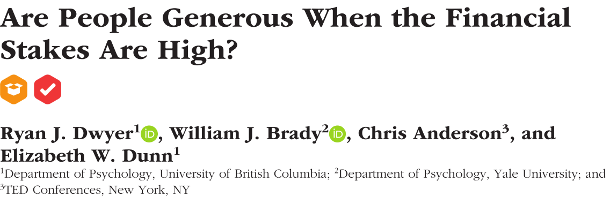
汇报人：贺哲

Slide 3
previous conclusions
Adam Smith‘s standard economic theory –It is not from the benevolence of the butcher, the brewer, or the baker that we expect our dinner， but from their regard to their own interest.
Human generosity across cultures, in children, and in our nearest nonhuman ancestors.
People‘s motivations for donating may be influenced by a variety of nonaltruistic factors, such as the pursuit of status and reputational concerns.
people may donate reactively to protect self-esteem but rarely do so proactively.

Slide 4
Inadequacy of previous research
The extent to which humans exhibit financial generosity in consequential real-world situations is essentially untested.
Existing lab studies may overestimate the extent to which people are generous.
Participants are forced to make artificial choices in response to the experiment’s rules.
These studies have disproportionately relied on homogenous samples that represent only a small fraction of humanity.

Slide 5
Method-participants
1 provided their demographic information and completed a brief baseline questionnaire assessing their personality and well-being.
2 from a wide range of socioeconomic backgrounds from both low-income countries-Brazil(n=8), Indonesia(n=50), and Kenya (n=39)-and high-income countries-Australia(n=12), Canada(n=12), the United Kingdom(n=25), and the United States (n=54).
3 manage an active Twitter account with more than 100 followers.
4 final sample: relatively young (M=34.2years,SD=12.1,range=21-75),educated(85%had a bachelor’s degree or higher),and liberal leaning(M=34.6,SD=18.6,on a scale form 0,left,to 100,right).

Slide 6
Method-procedure
public condition
private condition
procedure

Slide 7
Method-measures
participants completed extensive surveys 1,2,3,and 6 months after the cash transfer
in the 1,2,3 months after the cash transfer, participants reported how they spent the money(including, the cost and the recipient), and they reported separately.
calculated the total amount spent on each recipient category across the 3-month follow-up period

Slide 9
Method-measures
prosocial spending-narrower forms
manipulation check –what extent did the following impact your spending decision.
missing data- one participant failed to complete any surveys

Slide 10
Result
prosocial purchases＞the strictest interpretation of the standard economic model（t（199）=30.42，p＜.001,95% confidence interval（CI）=[$6014,$6848]，d=2.2².
participants did not simply spend the money generously on their immediate family members. ($3678 was spent on people outside the household)
generous spending extended beyond participants’ immediate social network($2056 was spent on strangers, acquaintances, and donations to organizations.

Slide 11
Result
participants spent money to benefit themselves.
using a stricter definition of prosocial spending, we found that participants
spent $ 4,388 on others, including spending $2964 outside the household and $1489 on donations to charities.
participants spent money in order to enhance their own reputation.
both groups spent similar amounts on others.(t(197)=0.69, p=0.494,95%CI=[-
544.7,$1125.3],d=0.10)
participants in the public condition were more influenced by their social network online and offline
additional exploratory analyses
participants from lower and high-income countries did not differ in overall prosocial spending, t(196)=-1.2,p=0.233,95%CI=[$-1519.9,$204.1],d=-0.21

Slide 13
Discussion
conclusion: 1 A wide definition of prosocial spending participants spent 68%of the cash gift generously vs a narrower definition 16 %.
2 control the effect of experimenter demands
3 public condition vs private condition
4 generous spending is infuenced by the donor couple ‘s initial act of generosity
5high income vs low income

Slide 14
Defect
a narrower definition of generous spending❓
the standard economic model❓
the experimental design❓

Slide 15
Thank you

