Slide 1
Cognitive Neuroscience
By YAN Zhixiong Ph.D

Slide 2
Cognitive neuroscience
Chapter 1 Overview
Course Features
Half on-line course
Presented in English and speak in Chinese.
On-line learning tasks and course website.
(认知神经科学：https://www.xuetangx.com/course/nnsfu10101002338/4231636;
课程网站：https://yanlab.club/index.php/cate/30.html;
生理与遗传基础：https://www.xuetangx.com/learn/nnsfu08301001894/nnsfu08301001894/4227225/article/6194223)
Discussion and Critical thinking
Better than just listening.

Slide 3
Cognitive neuroscience
Chapter 1 Overview

Slide 4
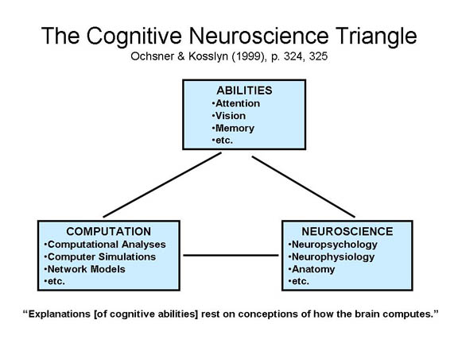
Cognitive neuroscience
Chapter 1 Overview
Cognitive neuroscience is a field of science that
strives to understand the ways in which the brain influences how people think, feel and act (the relationship between the brain and the mind).

Slide 5
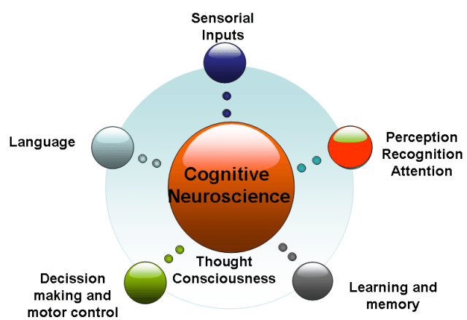
Cognitive neuroscience
Chapter 1 Overview
How mental functions are linked to neural processes.
Much of the early work comes from human neuropsychology that examined cognitive and emotional deficits in individuals who sustained brain damage.

Slide 6
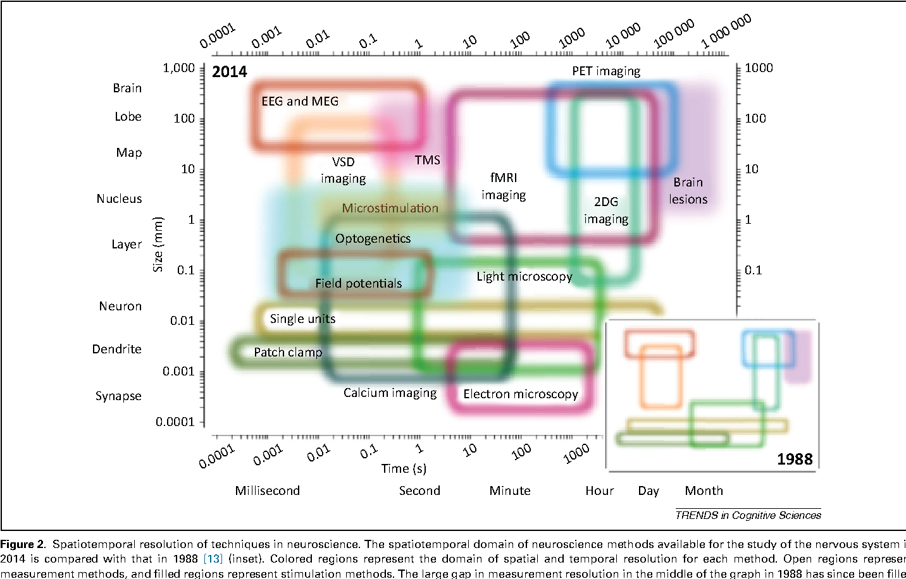
Cognitive neuroscience
Chapter 1 Overview
Methods

Slide 7
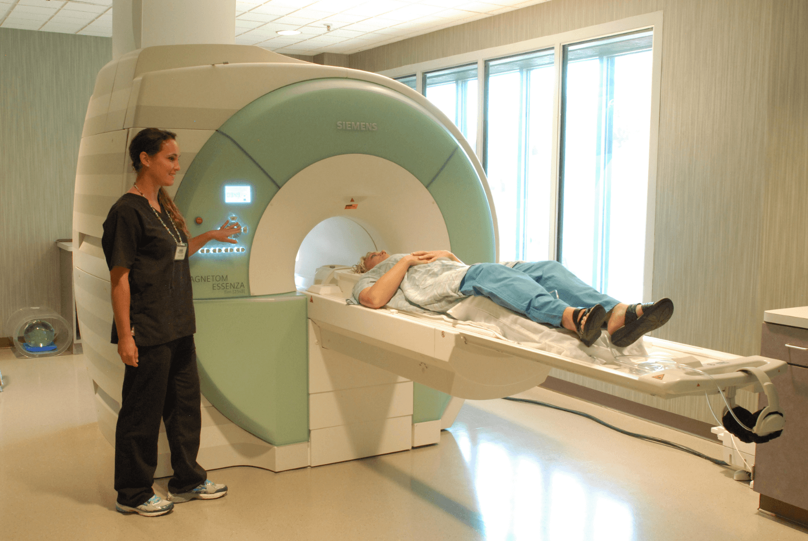
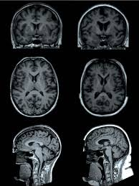
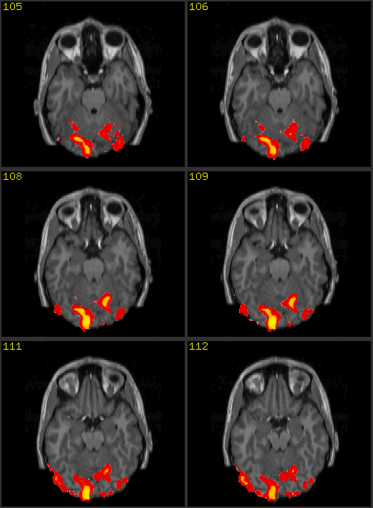
Cognitive neuroscience
Chapter 1 Overview
Methods

Slide 8
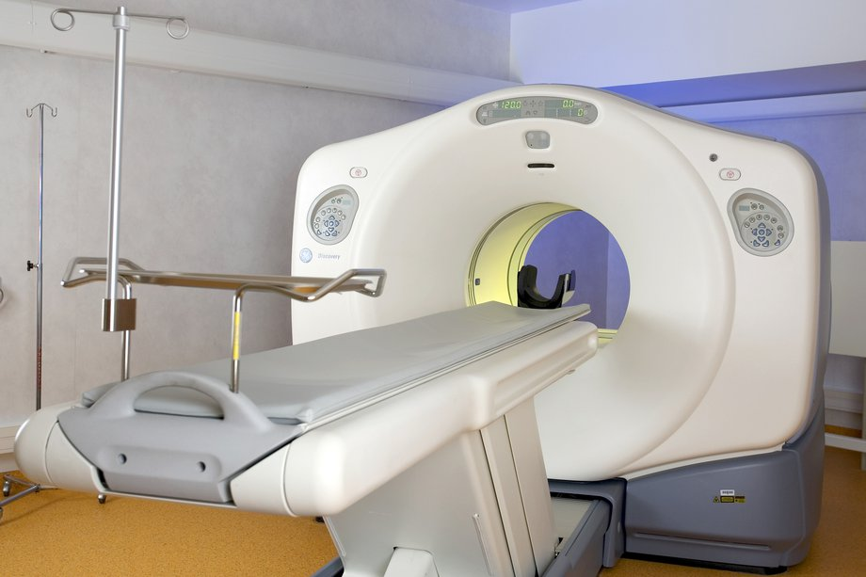
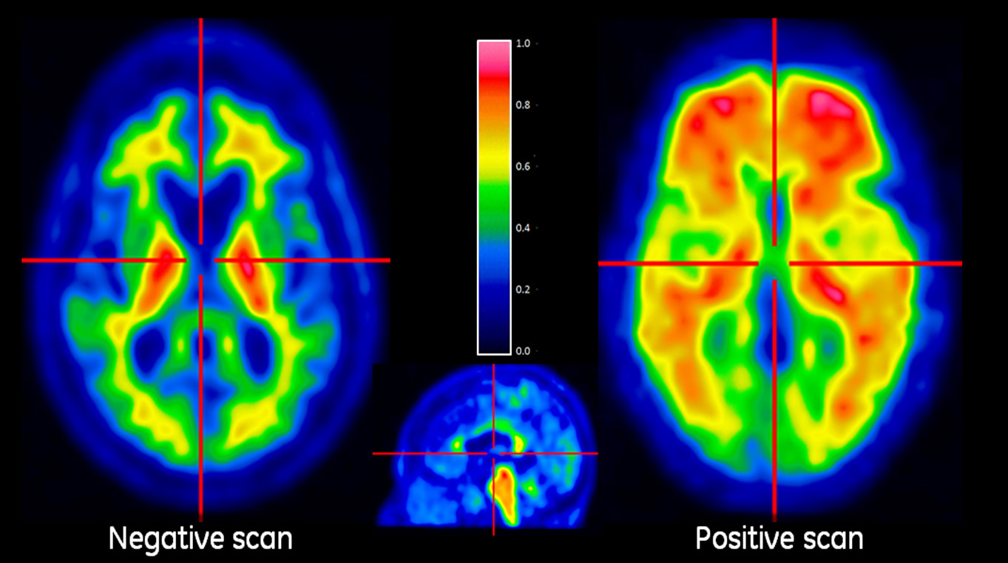
Cognitive neuroscience
Chapter 1 Overview
Methods

Slide 9
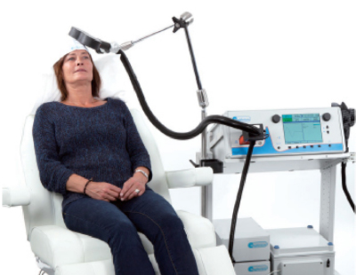
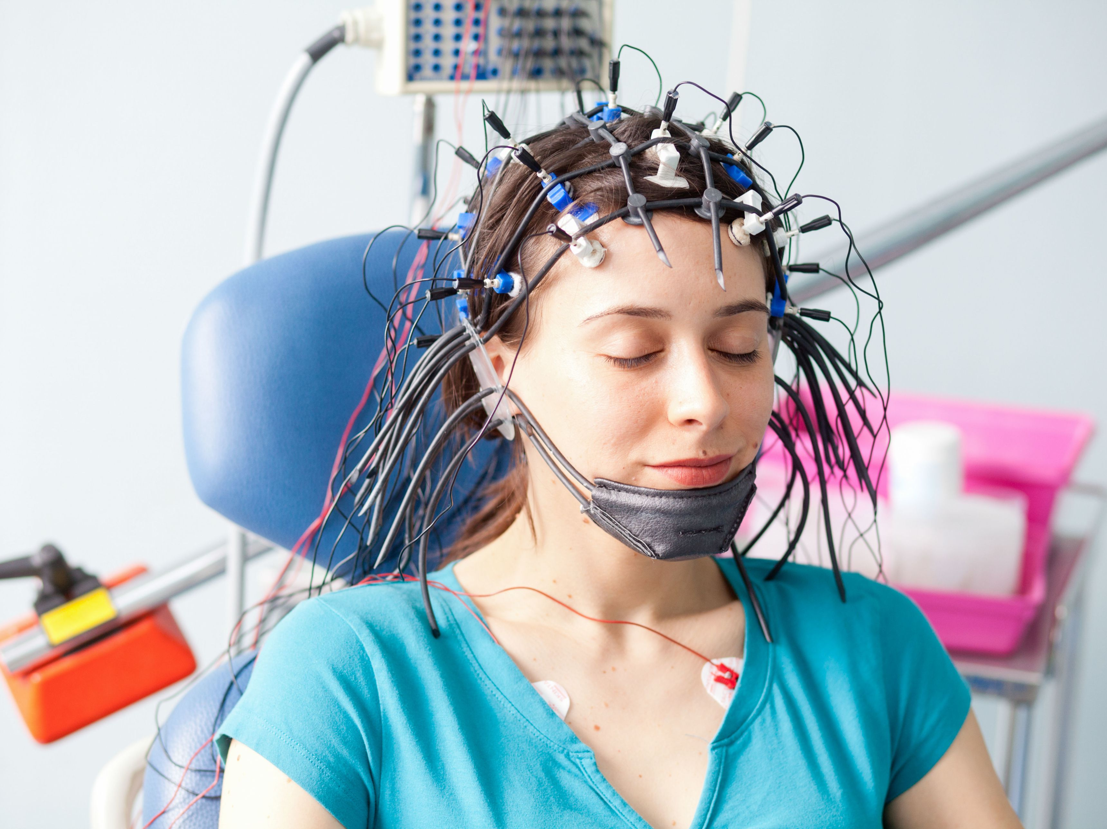
Cognitive neuroscience
Chapter 1 Overview
Methods

Slide 10
Cognitive neuroscience
Chapter 2 Nervous system
INTRODUCTION TO Nervous system
By YAN Zhixiong Ph.D

Slide 11
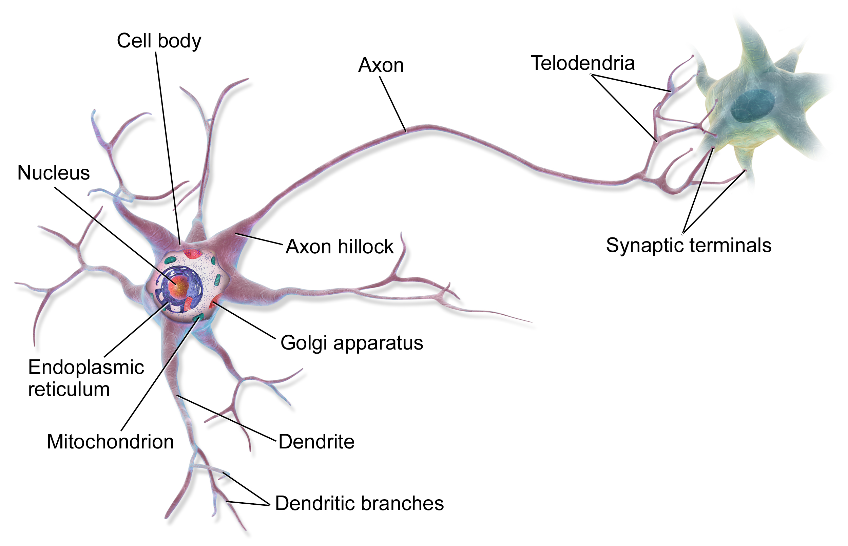
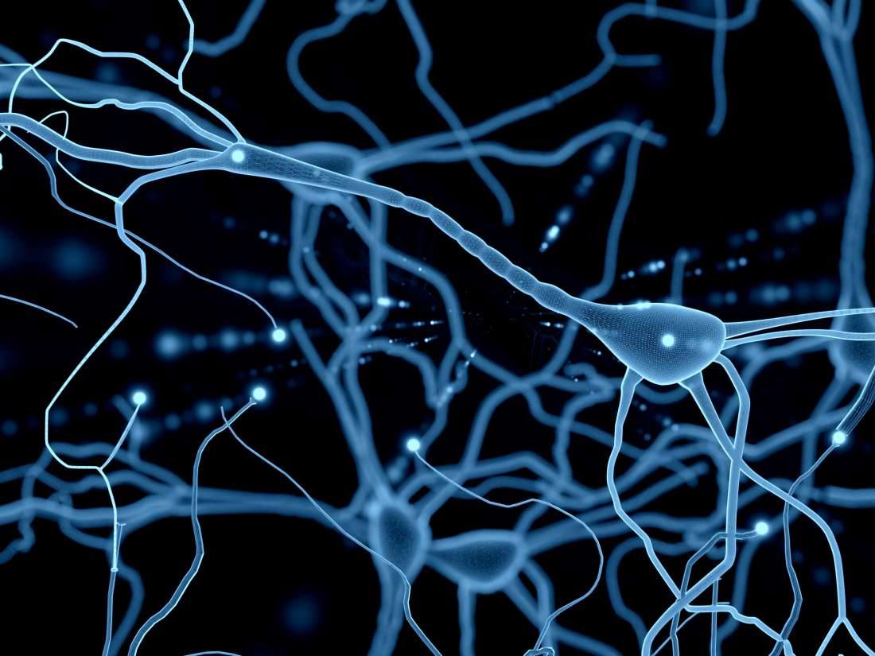
Cognitive neuroscience
Chapter 2 Nervous system
2.1 Neuron

Slide 12
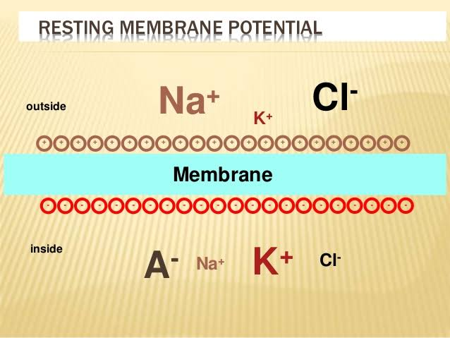
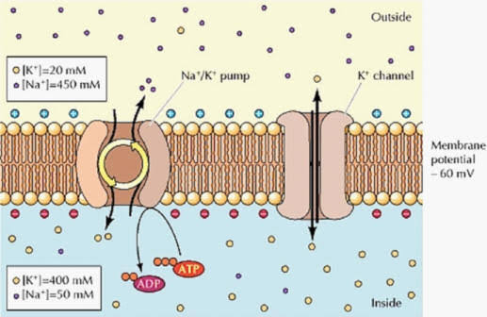
Cognitive neuroscience
Chapter 2 Nervous system
2.1 Neuron
Resting Potential

Slide 13
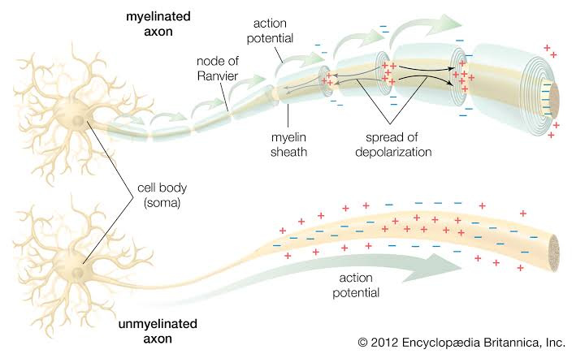
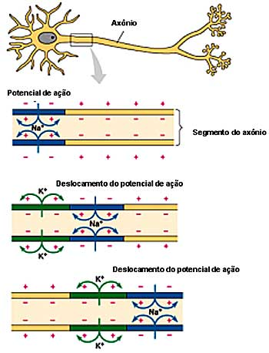
Cognitive neuroscience
Chapter 2 Nervous system
2.1 Neuron
Action Potential

Slide 14
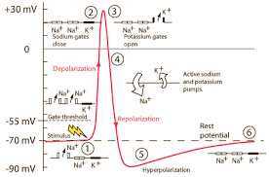
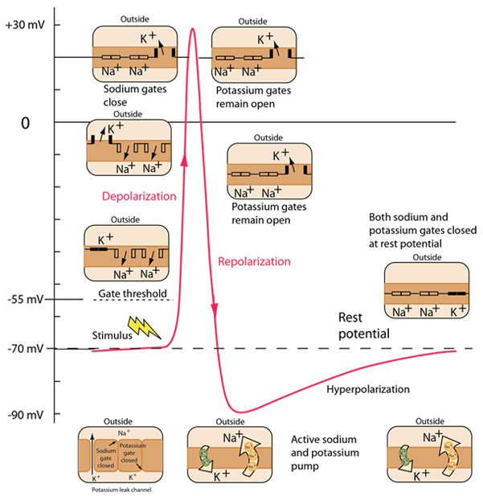
Cognitive neuroscience
Chapter 2 Nervous system
2.1 Neuron
Action Potential

Slide 15
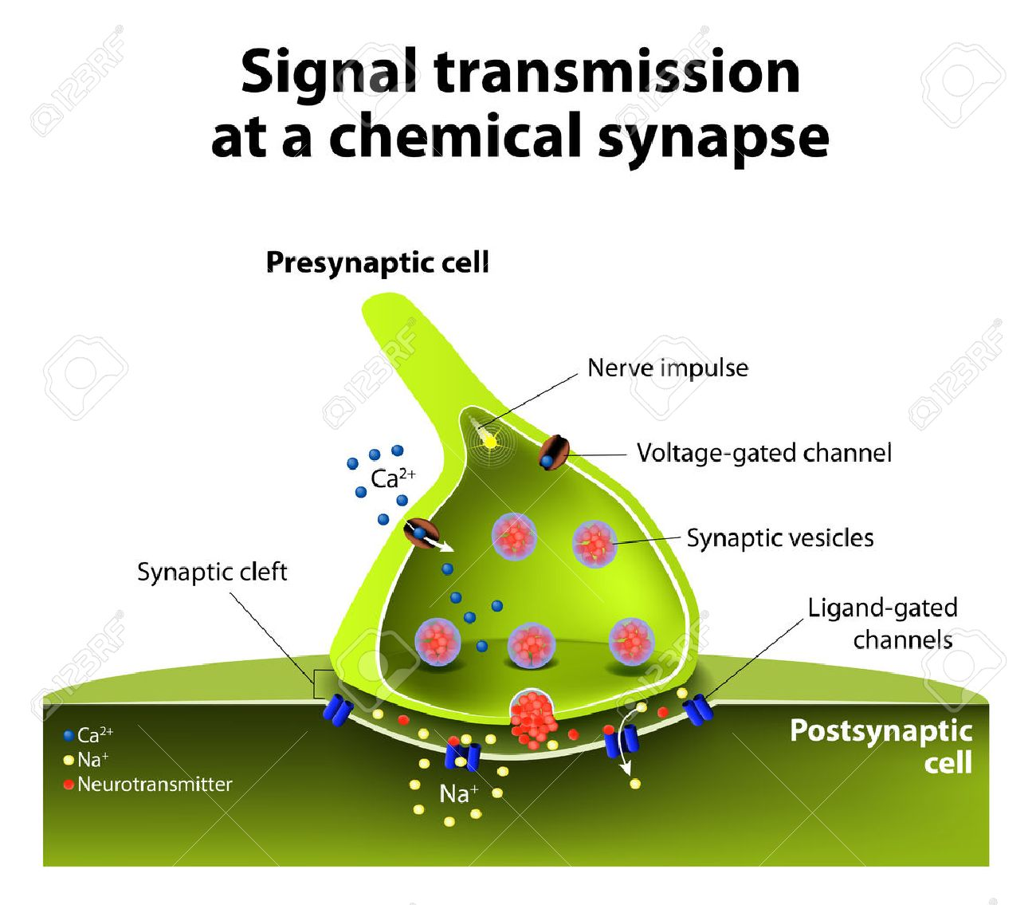
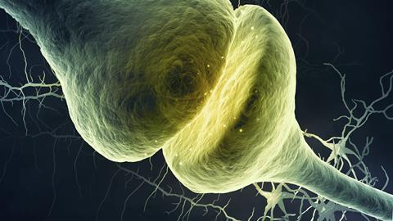
Cognitive neuroscience
Chapter 2 Nervous system
2.1 Neuron
Synaptic Transmission

Slide 16
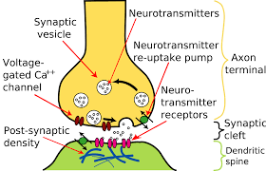
Cognitive neuroscience
Chapter 2 Nervous system
2.1 Neuron
Chemical Synaptise

Slide 17
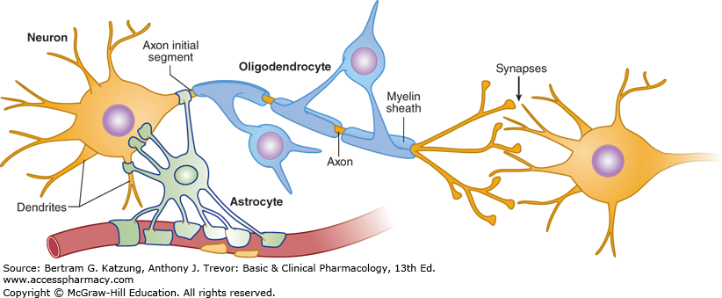
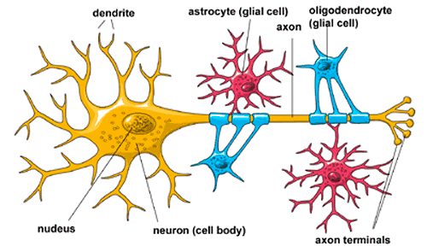
Cognitive neuroscience
Chapter 2 Nervous system
2.1 Neuron
Glia

Slide 18
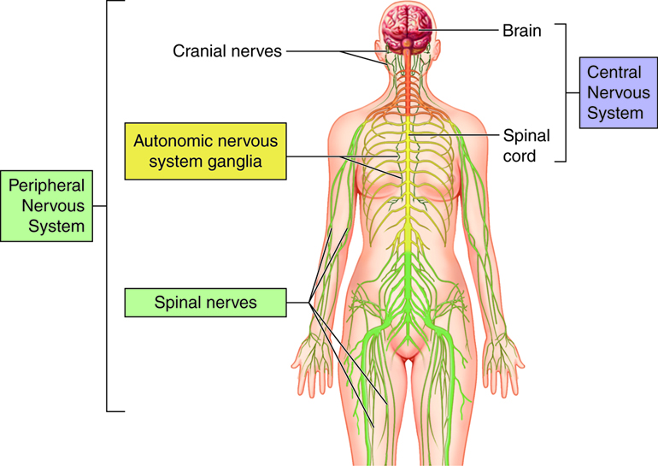
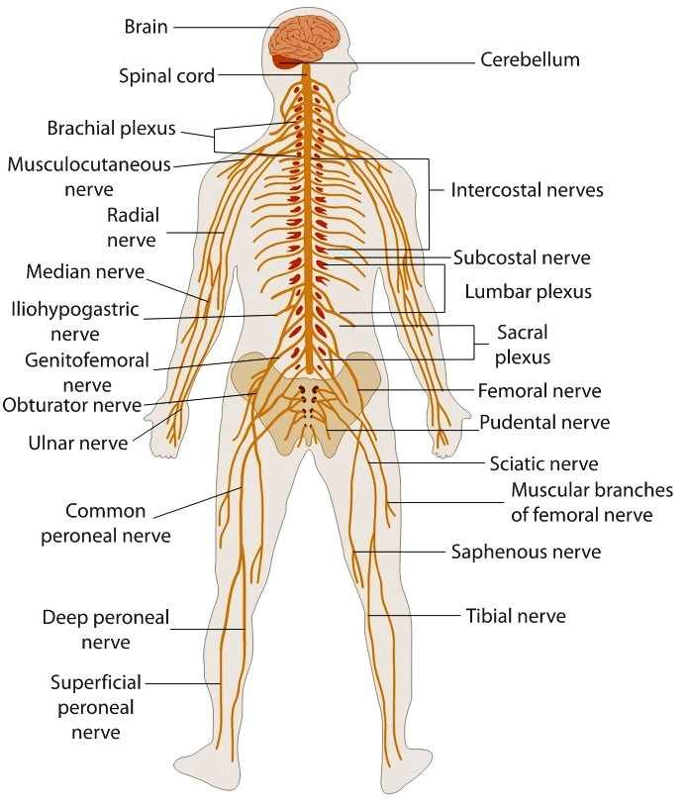
Cognitive neuroscience
Chapter 2 Nervous system
2.2 Nervous system

Slide 19
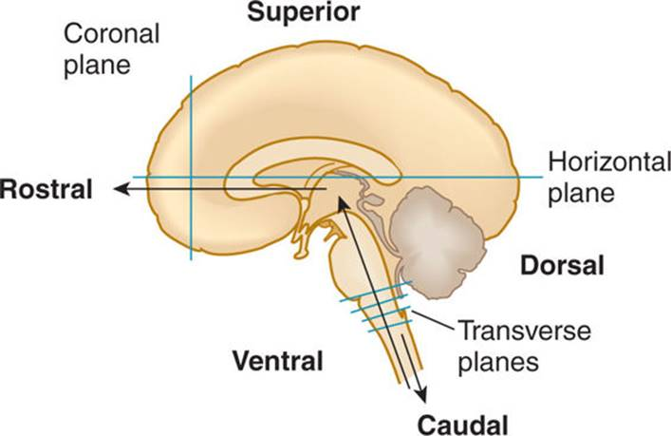
Cognitive neuroscience
Chapter 2 Nervous system
2.2 Nervous system
Neuroanatomical terms

Slide 20
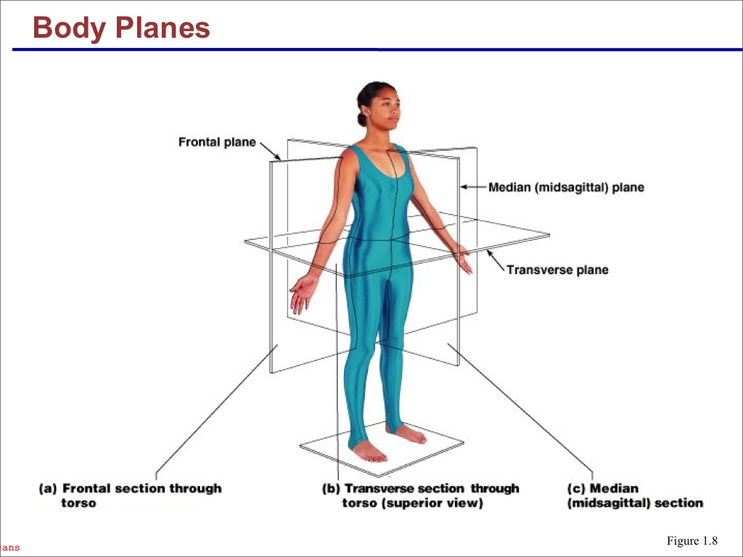
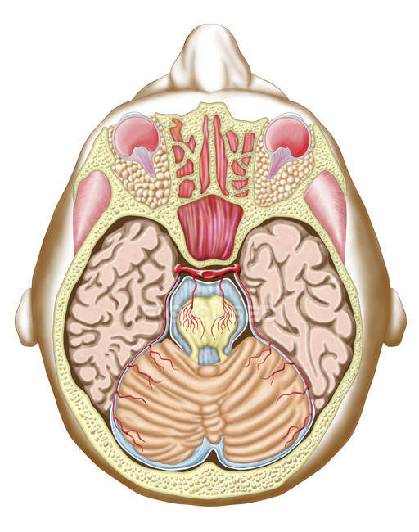
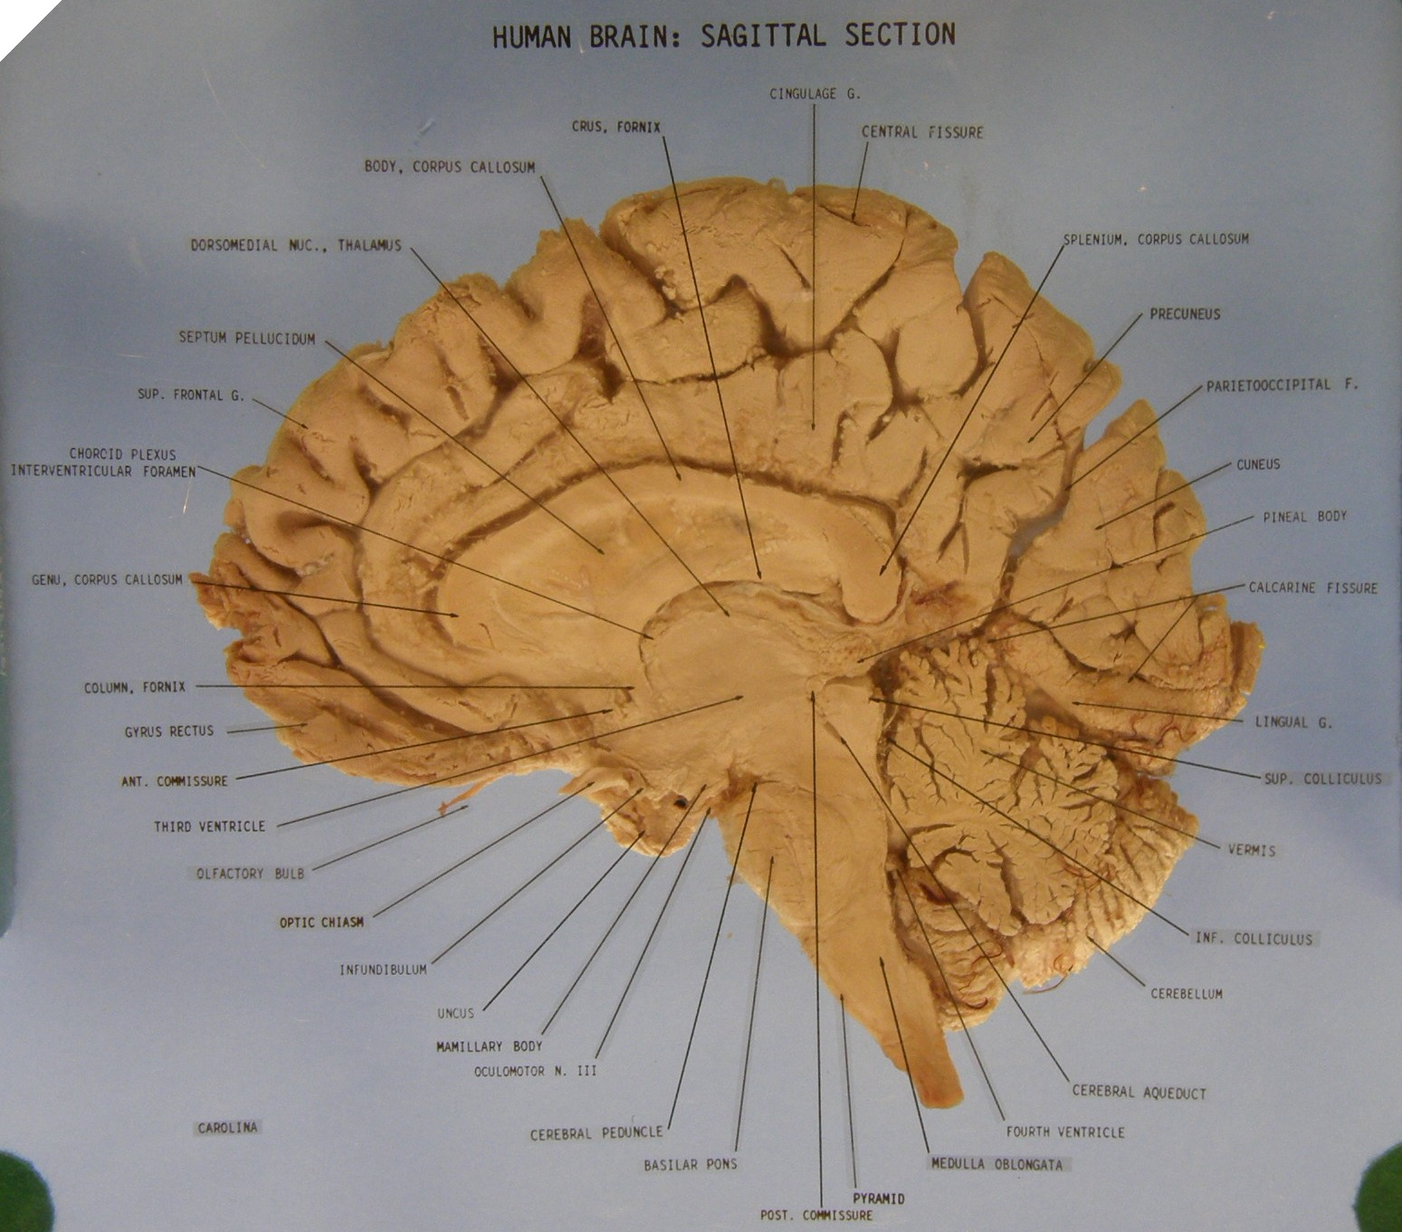
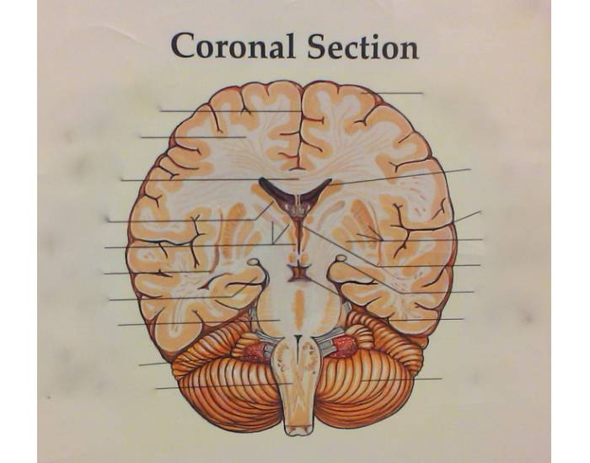
Cognitive neuroscience
Chapter 2 Nervous system
2.2 Nervous system
Neuroanatomical terms
Transverse
Sagital
Coronal

