Slide 1
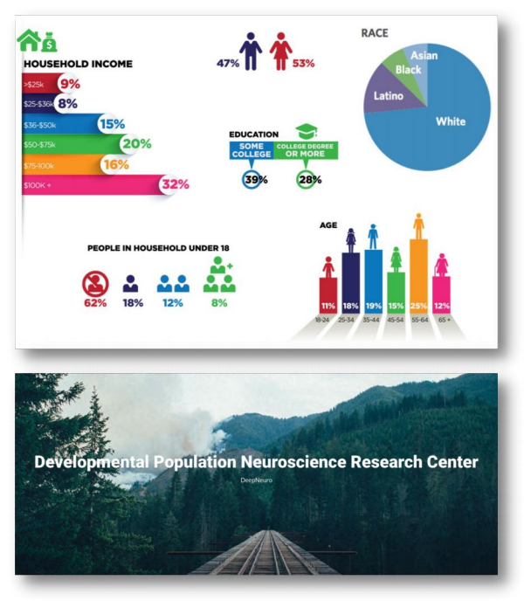
认知神经科学
与教育实验室
Developmental Population Neuroscience
发展人口神经科学 (个体人口统计资料)
左西年 (Xi-Nian Zuo)
Nanning Normal University
Key Lab of Cognitive Neuroscience & Educaiton
https://zuoxinian.github.io http://deepneuro.bnu.edu.cn

Slide 2
Lifespan Development: Population vs Individual
KeynoteAdresinChinese PsychologicalSociety(2018 Annual Meeting, Beijing)
左西年-中国心理学会 (cpsbeijing.org)

Slide 3
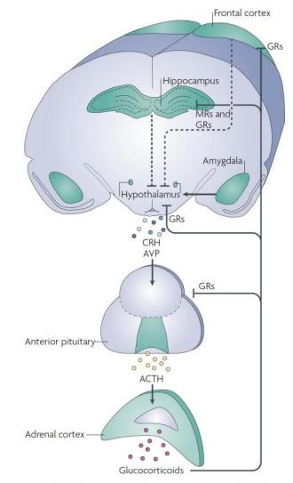
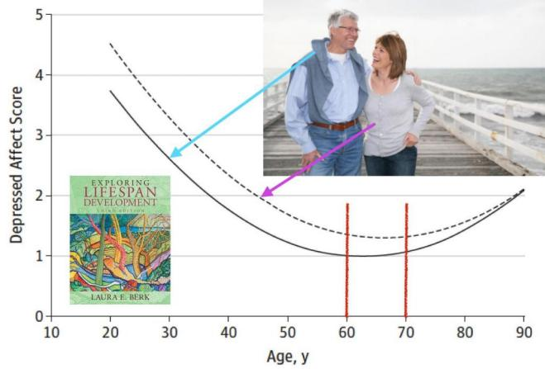
Lifespan Development: Population Neuroscience
JAMA Psychiatry(2014); NatureReviewsNeuroscience(2009)

Slide 4
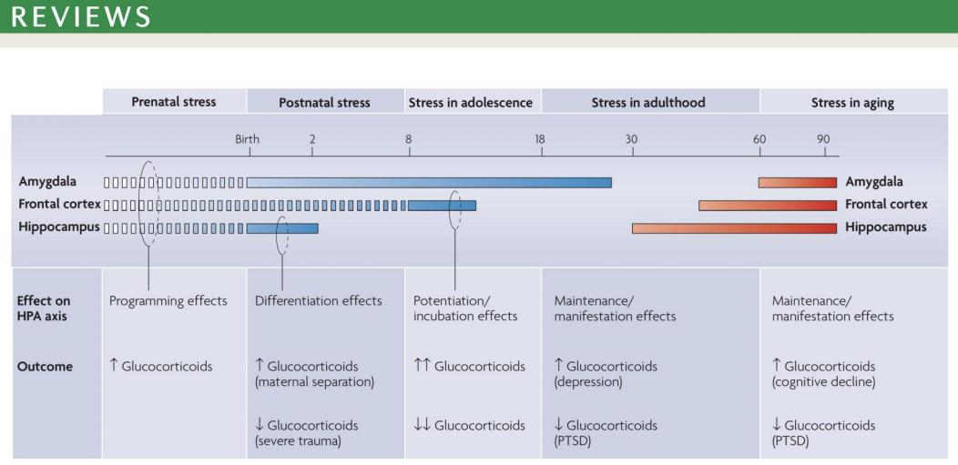
Lifespan Development: Multi-level Mechanisms
NatureReviewsNeuroscience(2009)

Slide 5
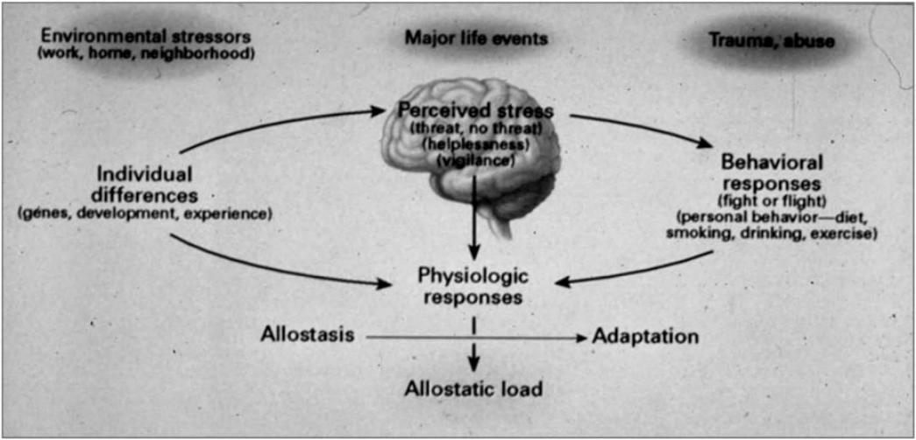
Lifespan Development: Multi-level Mechanisms
PNAS(2012)

Slide 6
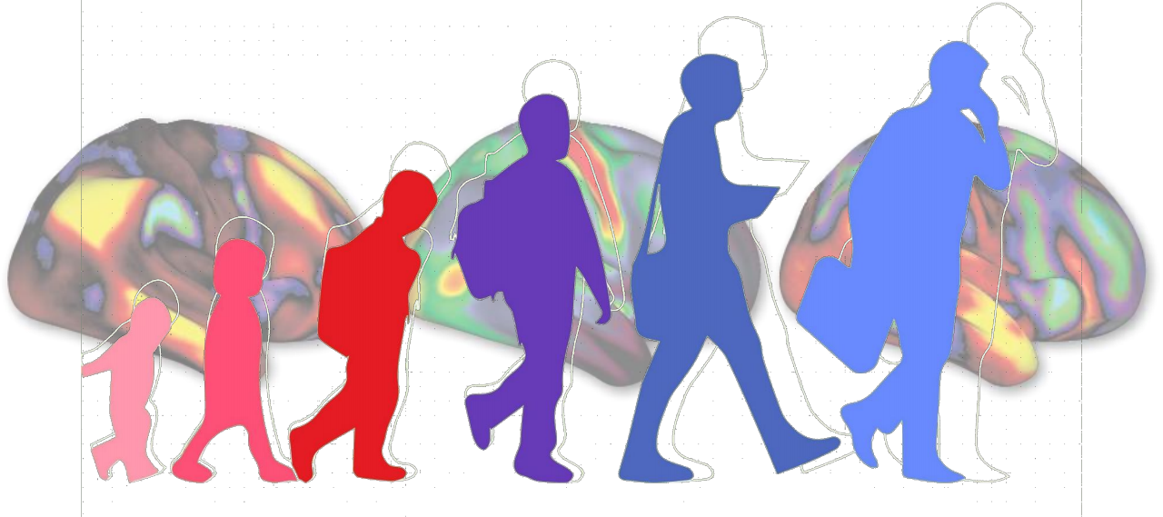
Brain Demography
Age
零岁出场亮相、 十岁天天向上、 二十远大理想、 三十基本定向
四十处处吃香、 五十奋发图强、 六十告老还乡 七十打打麻将、 八十晒晒太阳
九十躺在床上、 百岁挂在墙上

Slide 7
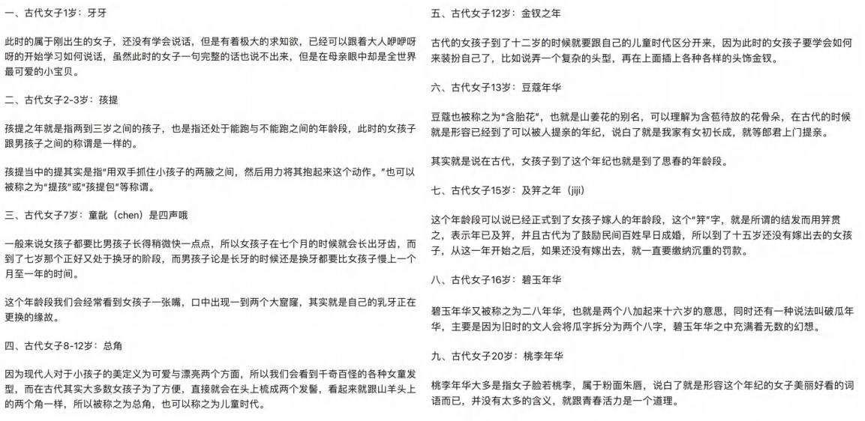
Brain Demography
Age

Slide 8
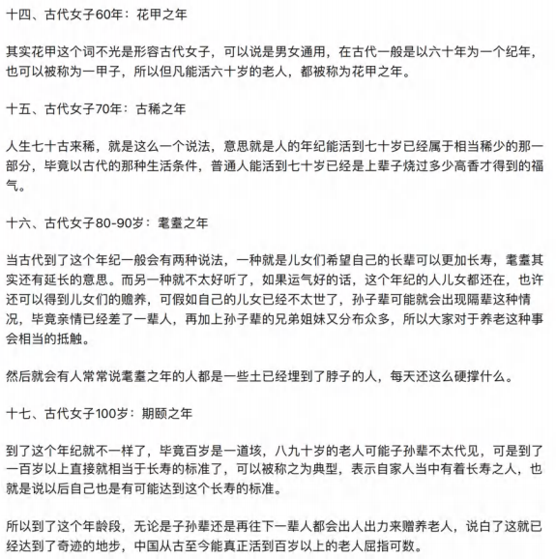
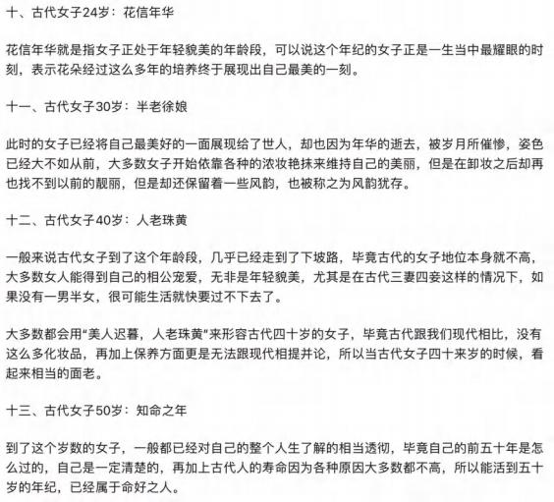
Brain Demography
Age

Slide 9
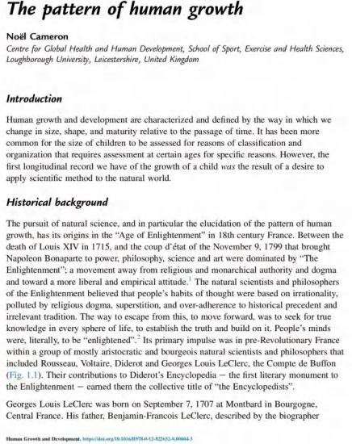
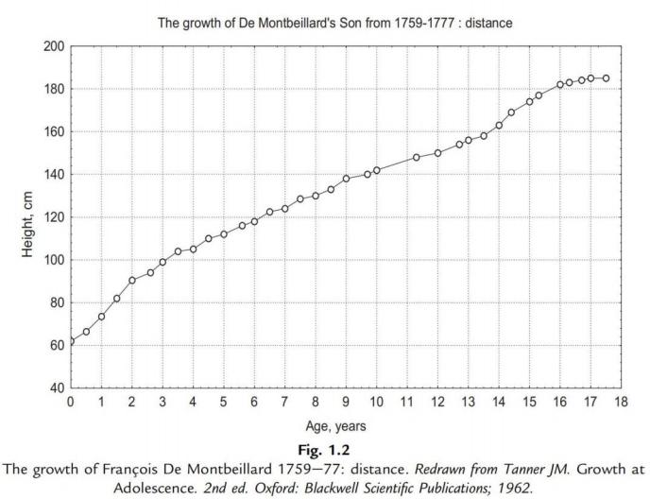
Brain Demography
Age
参 考 书 - 6

Slide 10
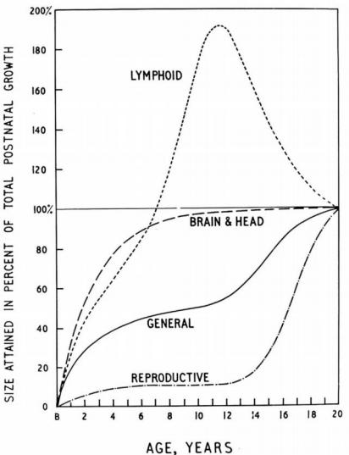
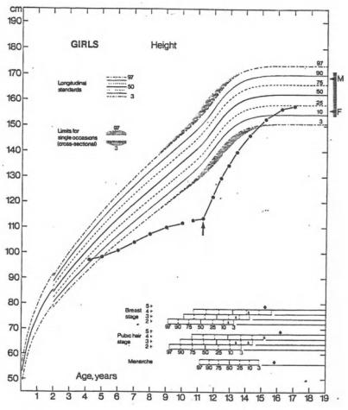
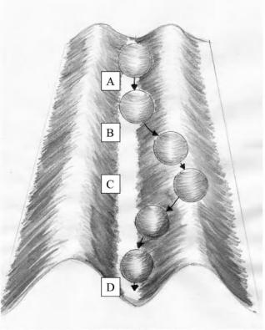
Brain Demography
Age

Slide 11
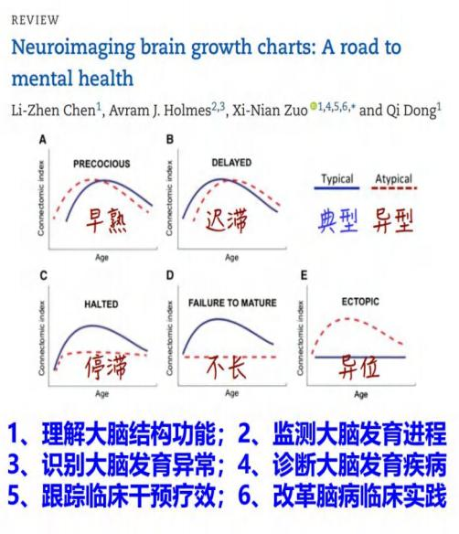
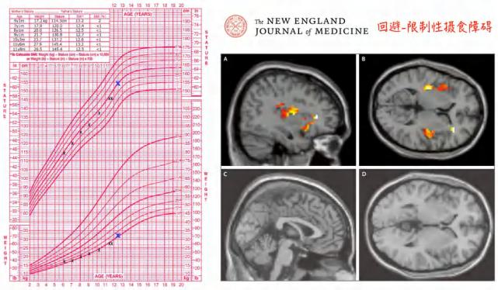
Brain Demography
Age

Slide 12
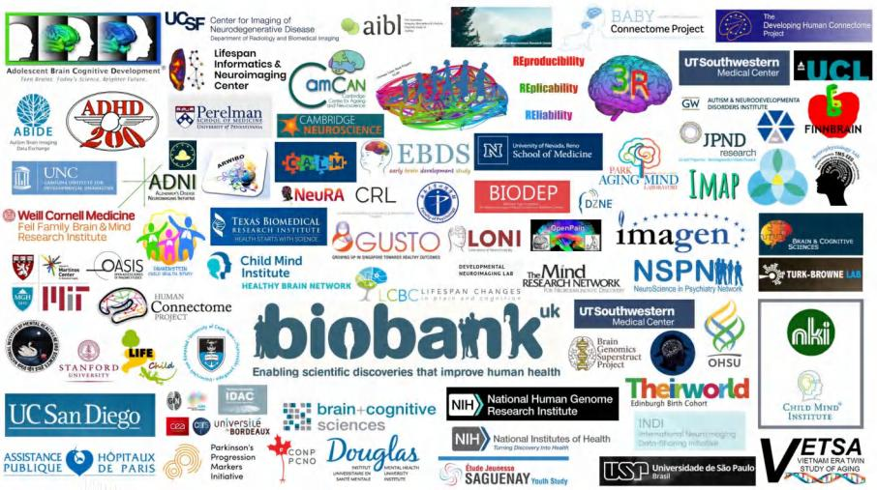
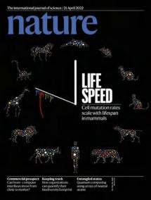
Brain Demography
Age
• > 100 datasets
• > 100k participants
• > 120k samples
• Ages: 115 days -
100 years
• Team work
• Open science
• Reproducibility
Brain Charts for The Human Lifespan; Nature (2022) 604:525-533 (https://www.brainchart.io)

Slide 13
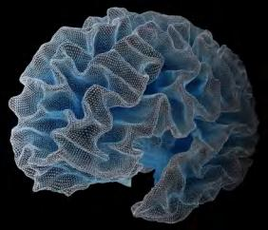
Brain Demography
Age
https://surfer.nmr.mgh.harvard.edu

Slide 14
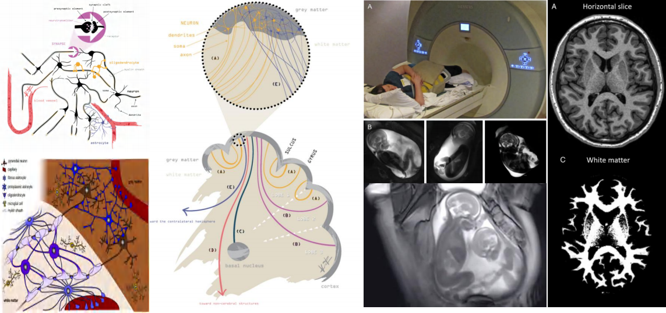
Brain Demography
Age
微观
介观
宏观
胎儿
成人

Slide 15
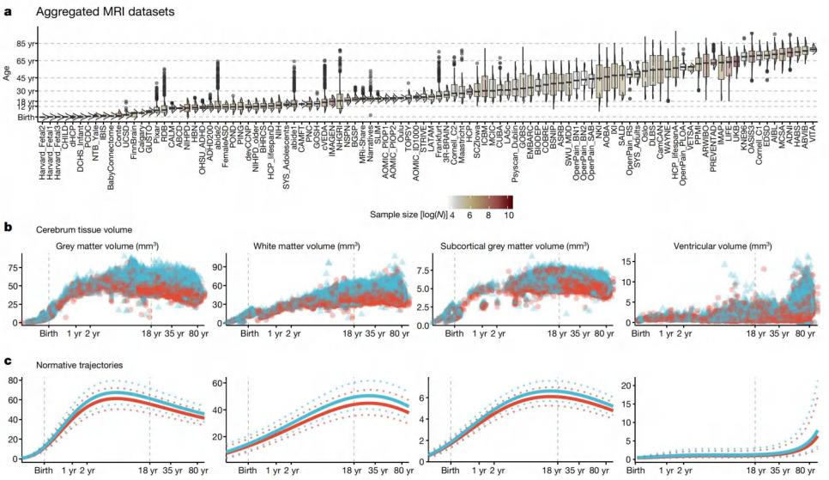
Brain Demography
Age
Brain Charts for The Human Lifespan; Nature (2022) 604:525-533 (https://www.brainchart.io)

Slide 16
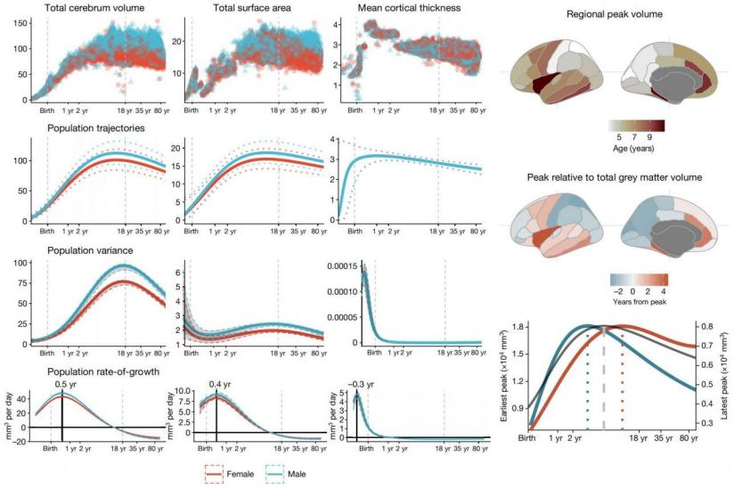
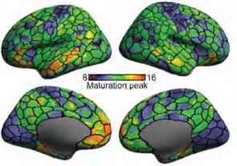
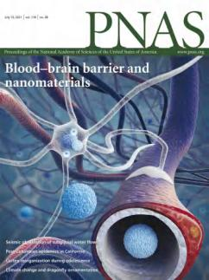
Brain Demography
Age
Brain Charts for The Human Lifespan; Nature (2022) 604:525-533 (https://www.brainchart.io)

Slide 17
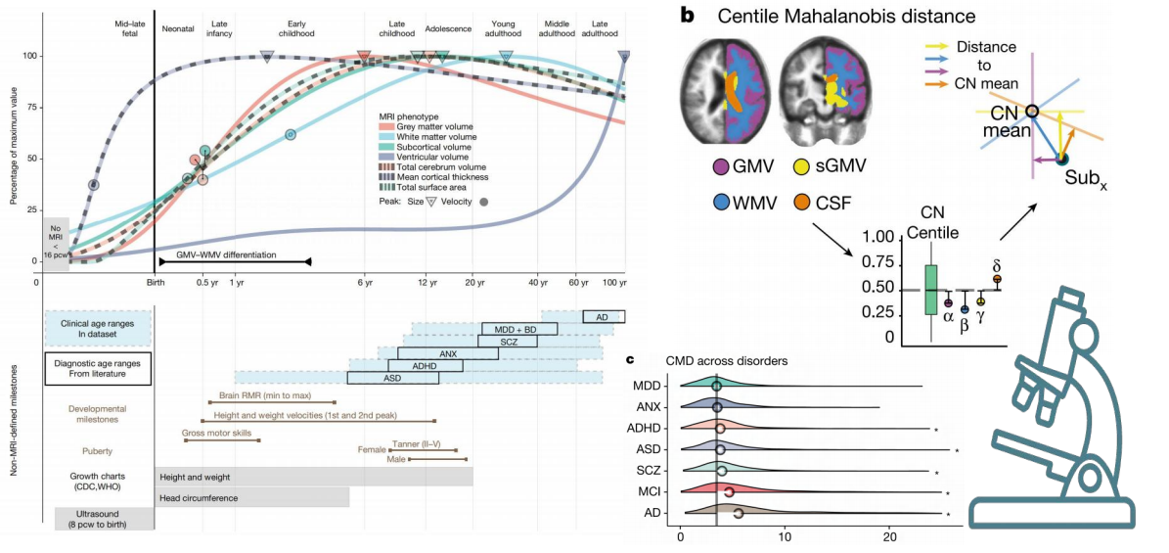
Brain Demography
Age
Brain Charts for The Human Lifespan; Nature (2022) 604:525-533 (https://www.brainchart.io)

Slide 18
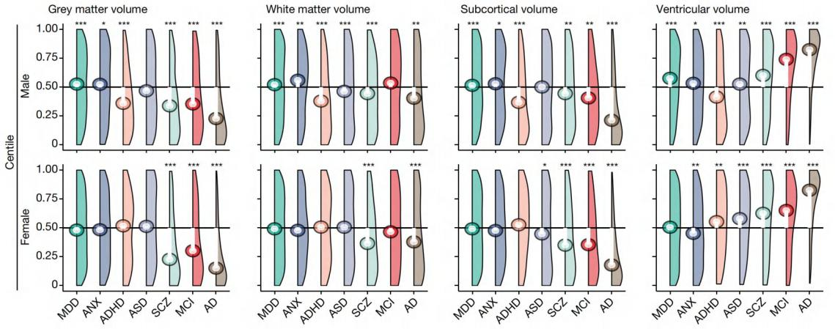
Brain Demography
Age
Brain Charts for The Human Lifespan; Nature (2022) 604:525-533 (https://www.brainchart.io)

Slide 19
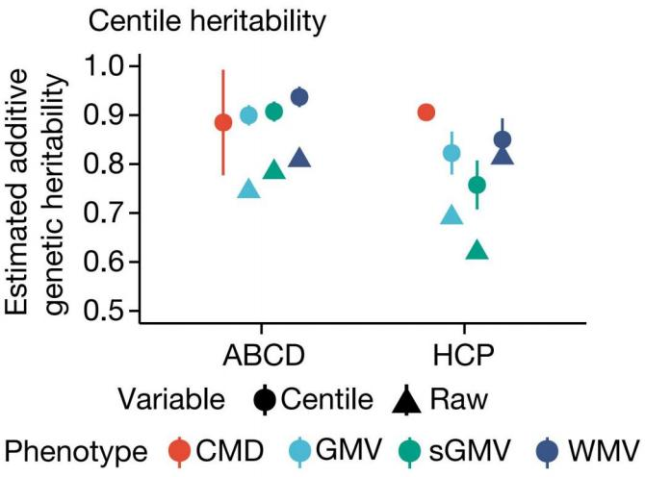
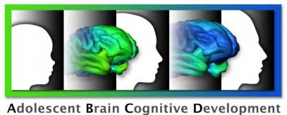
Brain Demography
Age
Brain Charts for The Human Lifespan; Nature (2022) 604:525-533 (https://www.brainchart.io)

Slide 20
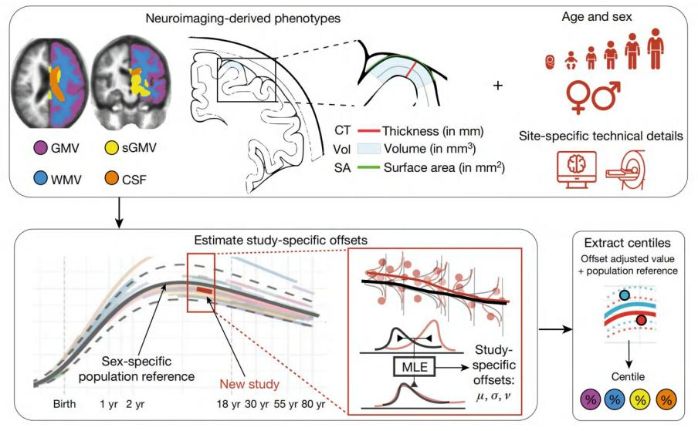
Brain Demography
Age
Brain Charts for The Human Lifespan; Nature (2022) 604:525-533 (https://www.brainchart.io)

Slide 21
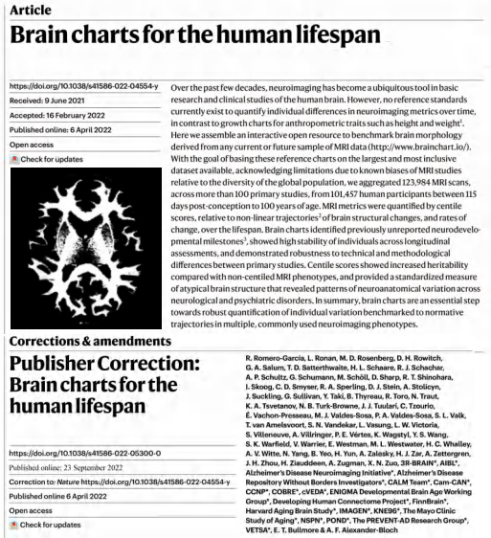
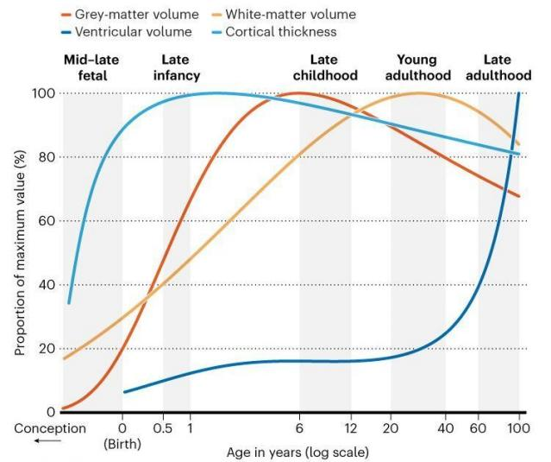
Brain Demography
Age
Brain Charts for The Human Lifespan; Nature (2022) 604:525-533 (https://www.brainchart.io)

Slide 22
Brain Demography
Age
全景
Brain Charts for The Human Lifespan; Nature (2022) 604:525-533 (http:/deepneuro.bnu.edu.cn/?p=625)

Slide 23
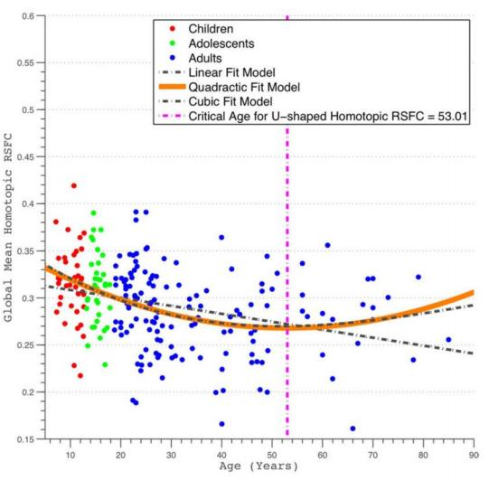
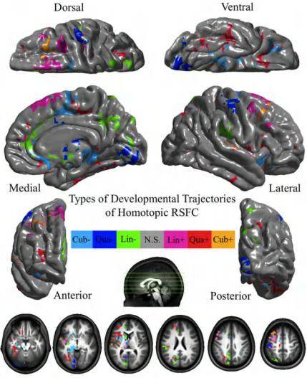
Brain Demography
Sex
The Journal of Neuroscience (2010) 30: 15034- 15043

Slide 24
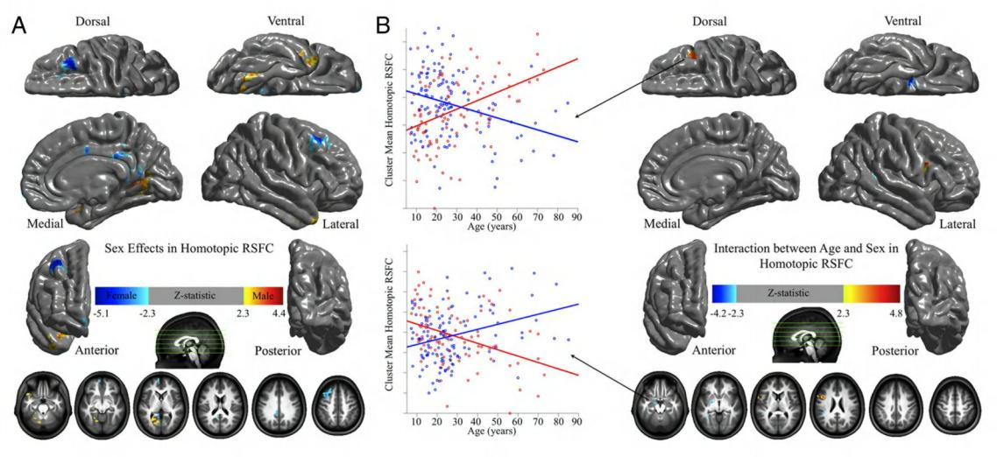
Brain Demography
Sex
The Journal of Neuroscience (2010) 30: 15034- 15043

Slide 25
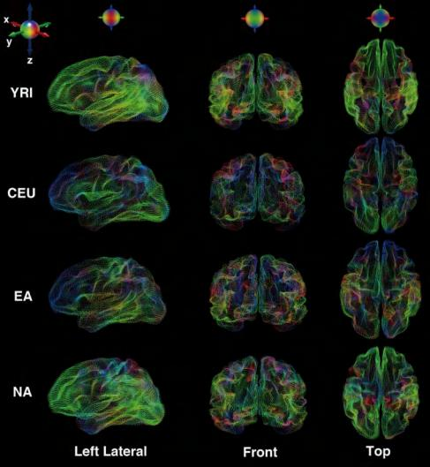
Brain Demography
Ethnicity
Current Biology (2015) 25: 1988- 1992

Slide 26
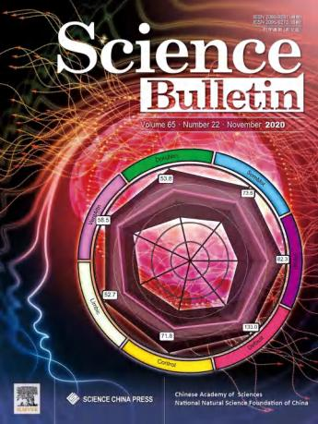
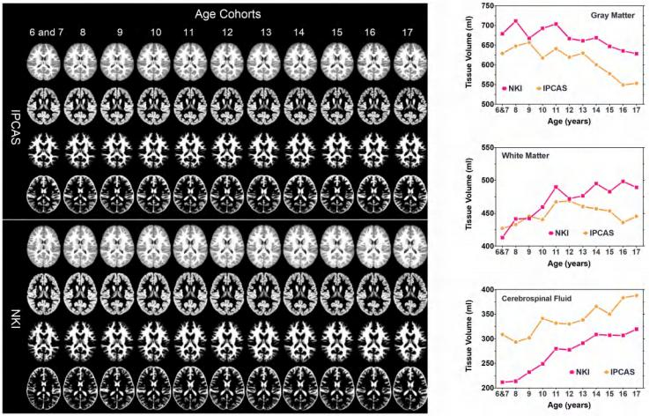
Brain Demography
Ethnicity
Science Bulletin (2020) 22: 1924- 1934

Slide 27
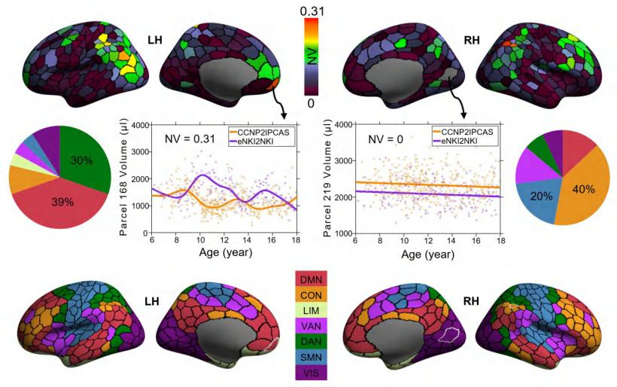
Brain Demography
Ethnicity
• Shape analyses revealed volumetric differences in growth curves between the two samples primarily in lateral frontal-parietal areas.
• These regions spatially distributed into default and control networks and are
most variable across individuals in regard to their structure and function.
• Temporally, the shape distinction of growth mostly occurred around the puberty period.
Default PFC
3
Vis 19
_ _
_
Science Bulletin (2020) 22: 1924- 1934

Slide 28
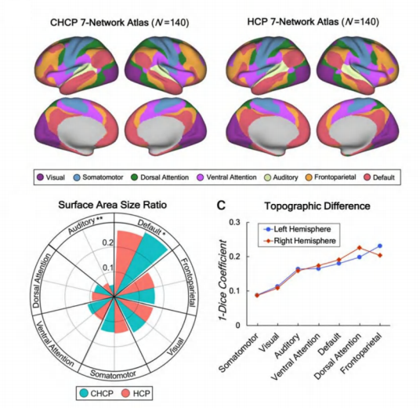
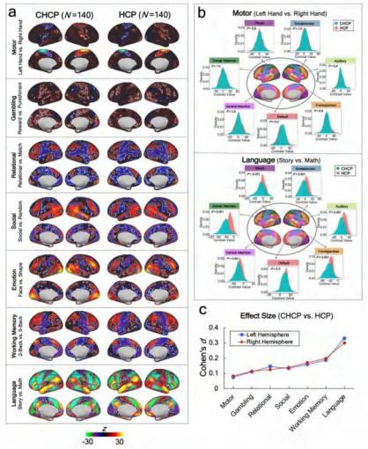
Brain Demography
Ethnicity
Nature Neuroscience (2022) in revision

Slide 29
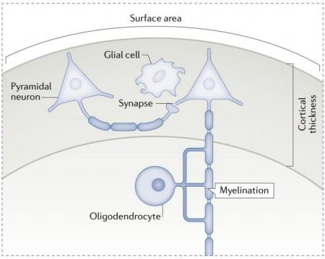
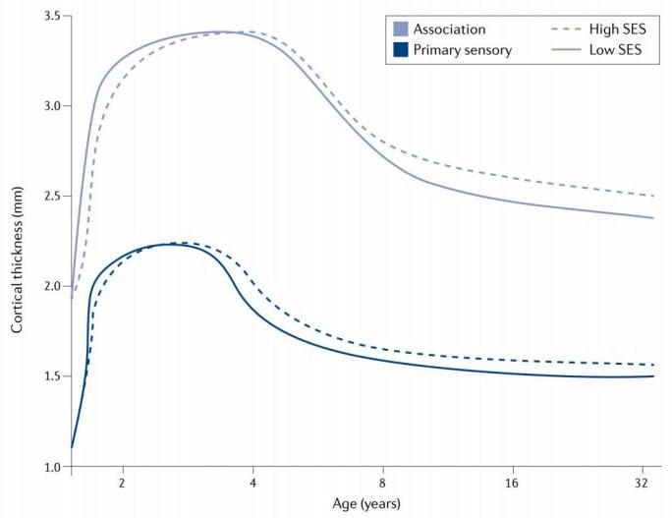
Brain Demography Socioeconomic Status
Behavioral and Brain Sciences (2010) 33:61-83; Nature Reviews Neurosciences (2021) 22:372-384

