Slide 1
认知神经科学
与教育实验室
Developmental Population Neuroscience
发展人口神经科学(学科史简介)
左西年 (Xi-Nian Zuo)
https://zuoxinian.github.io http://deepneuro.bnu.edu.cn
Nanning Normal University
Key Lab of Cognitive Neuroscience & Educaiton

Slide 2
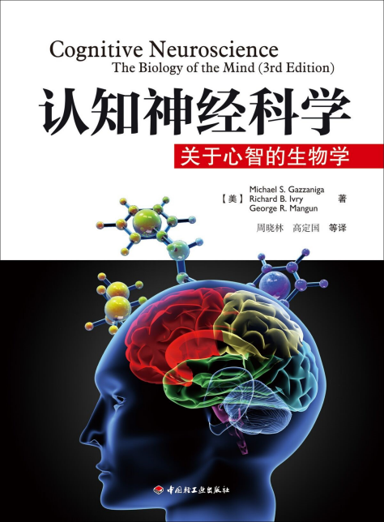
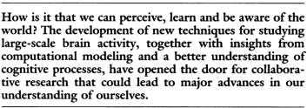
参 考 书 - 1
Cognitive neuroscience is a subfield of neuroscience that studies the biological processes that underlie human cognition, especially regarding the relation between brain structures, activity, and cognitive functions. The purpose is to determine how the brain functions and achieves performance. Cognitive neuroscience is considered as a branch of both psychology and neuroscience, because it combines the biological sciences with the behavioral sciences, such as psychiatry and psychology. Technologies that measure brain activity, like functional neuroimaging, can provide insight into behavioral observations when behavioral data is insufficient. Decision-making is an example of a biological process that influences cognition.

Slide 3
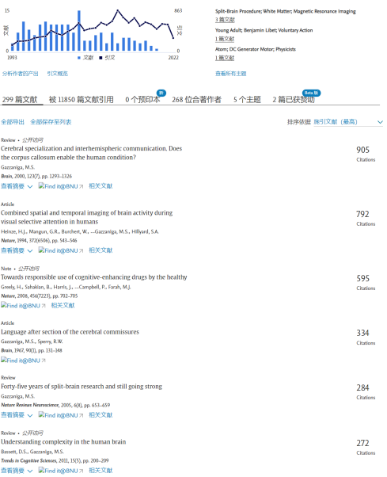
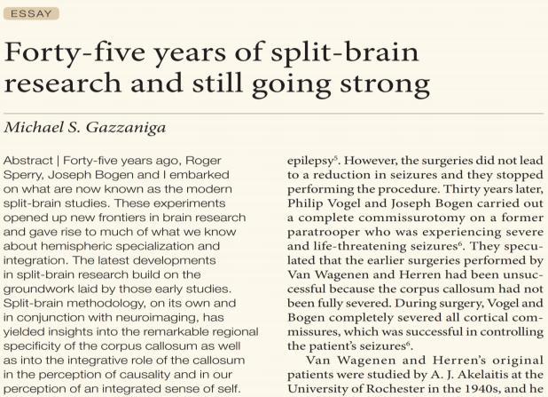
1 9 7 x 提 出 认 知 神 经 科 学

Slide 4
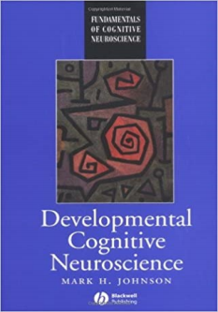
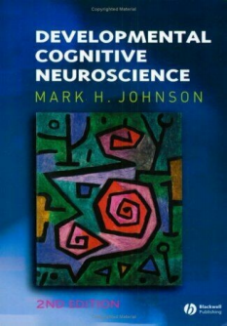
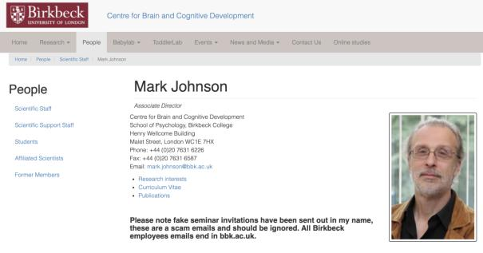
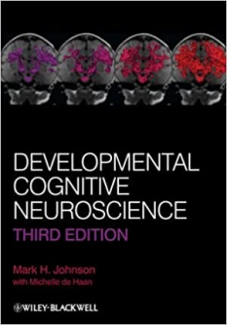
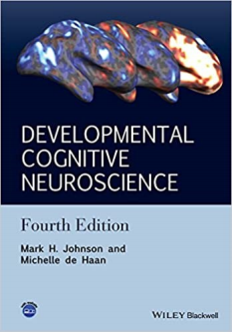
参 考 书 - 2

Slide 5
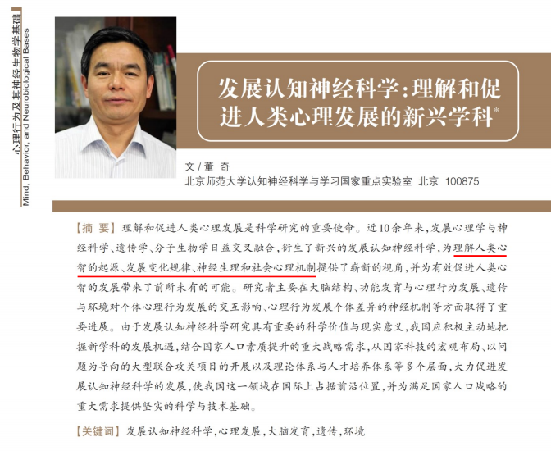

Slide 6
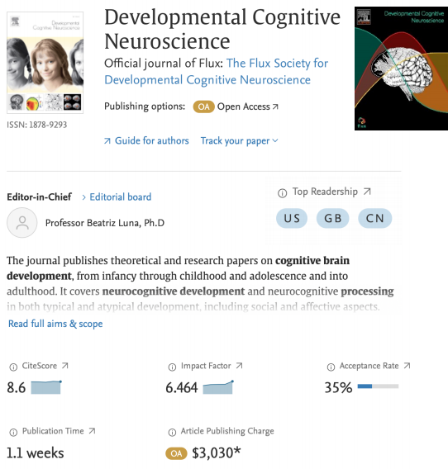
https://fluxsociety.org

Slide 7
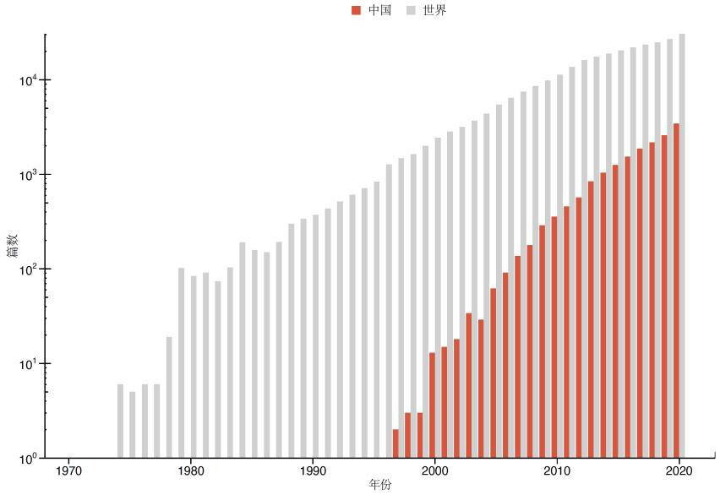
Publication Trends

Slide 8
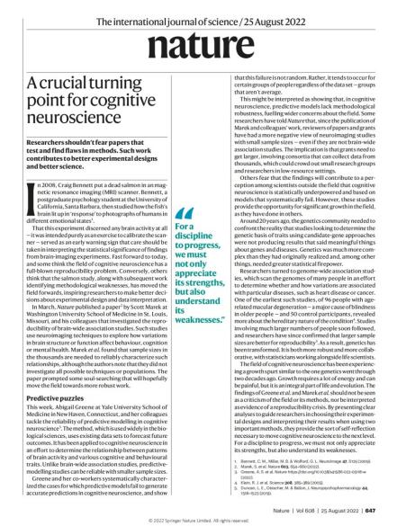
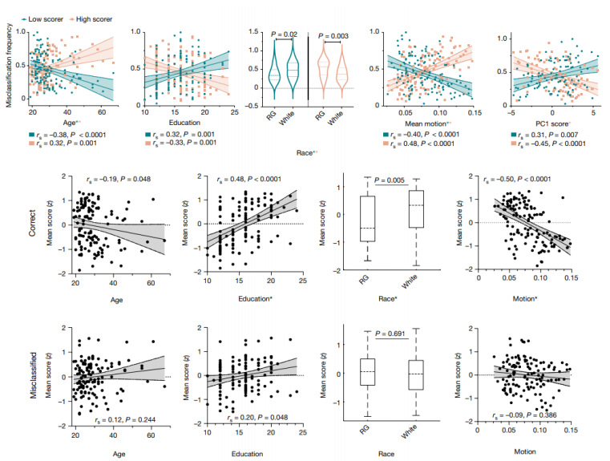
认知神经科学转折点
人口学因素是脑智关系建模的关键变量

Slide 9
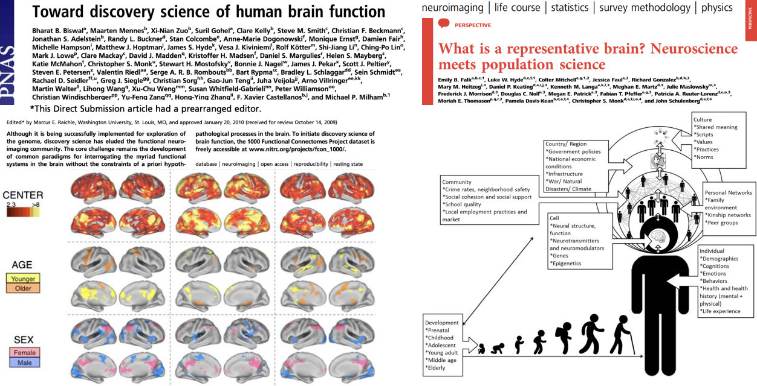
直 接 投 递 预 派 编 委
可重复性
开放科学

Slide 10
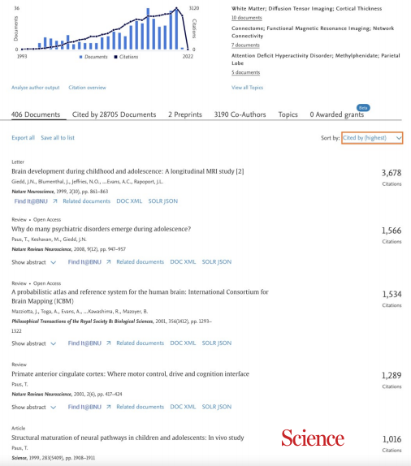
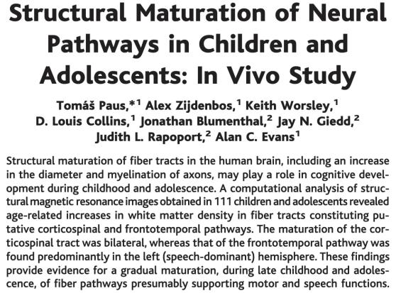

Slide 11
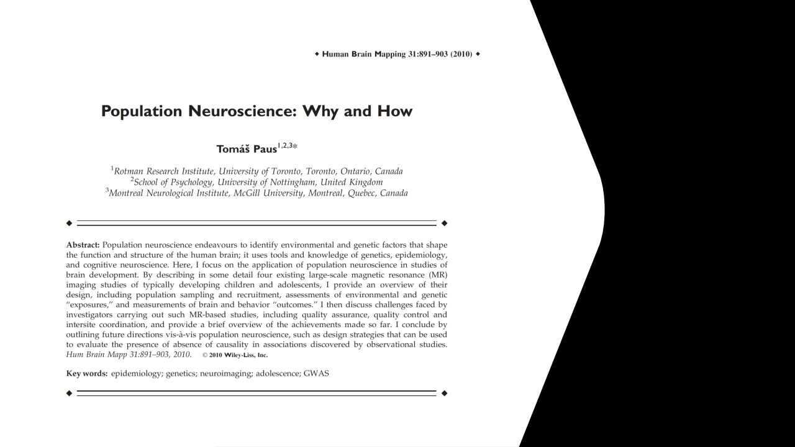
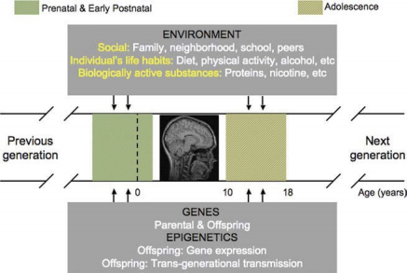
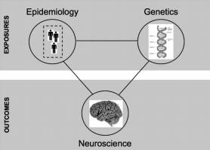
遗传学 流行病学
认知神经科学

Slide 12
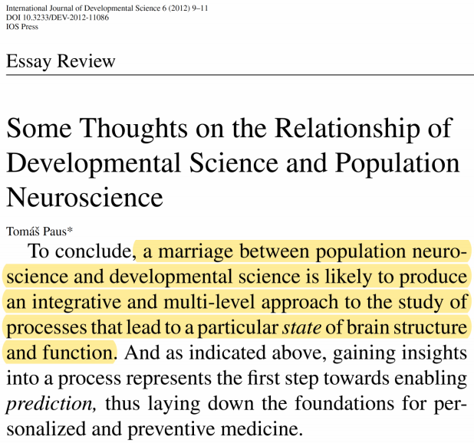
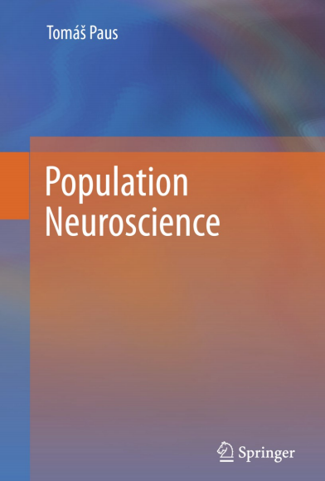
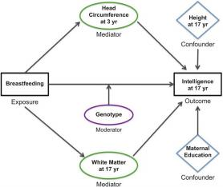
人口神经科学联姻发展科学
参 考 书 - 3

Slide 13
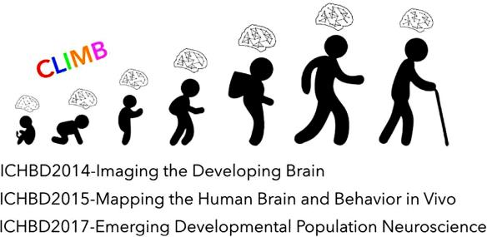

Slide 14
解码脑智生命时空、架构学科知识体系
Developmental Population Neuroscience: Emerging from ICHBD
DPN Course (since 2021) http://deepneuro.bnu.edu.cn/?p=43&page=2

Slide 15
2022 | 准备中【十四五认知神经科学书系】

